Slide 1
Network Approaches to Representing and Understanding Psychological Dynamics
Emorie D Beck and Joshua J Jackson
Washington University in St. Louis

Slide 2
Extraversion
Agreeableness
Conscientiousness
Neuroticism
Openness
Nomothetic
Notes:
From its inception, the study of personality has had two broad goals. One, a nomothetic approach, examines the structure of individual differences between people. The most dominant nomothetic model is the Big 5, E, A, C, N, O. The big 5 have become so uniqutous within personality psychology and predict a number of consequential outcomes and show normative patterns of change and development

Slide 3
Extraversion
Agreeableness
Conscientiousness
Neuroticism
Openness
Idiographic
Notes:
The second, an idiographic approach, asks questions about the structure and development of personality at the level of a single person relative to only him or herself. Despite a small number of studies examining the individual level structure of personality, idiographic studies of personality have been much more limited

Slide 4
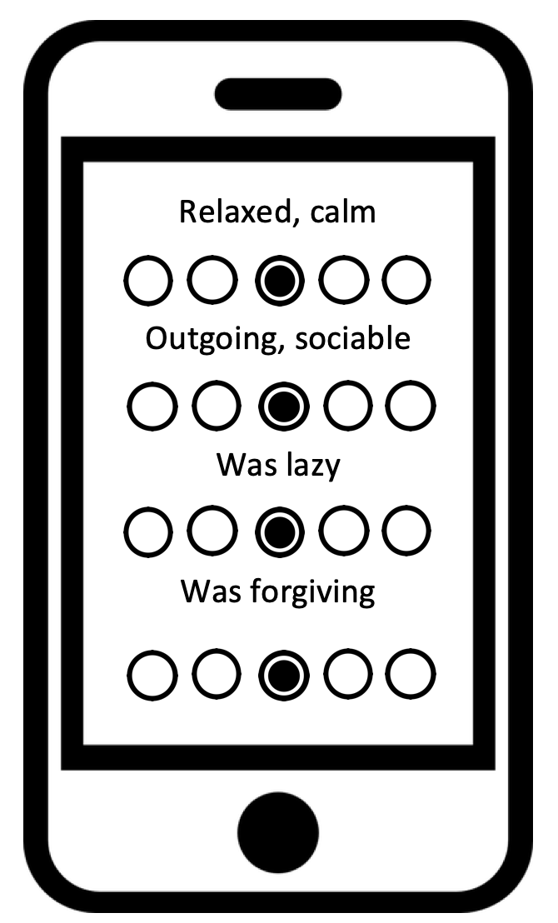
Notes:
In part, this is because to do idiographic research, we need special kinds of data
Historically this was interviews and sessions with clinicians
Today, though we have smartphones that allow to get repeated assessments of individuals

Slide 5
Notes:
But this gap in the prevalence of nomothetic and idiographic approaches may be more ominous than it appears as recent research suggests that the differences between these two approaches are critical for understanding causal processes in personality as well mechanisms underlying it.
Some of these critiques have come at the level of the model that is thought to underlie these data (the data generator).

Slide 6
Reflective
E
A
C
N
O
E₁
E₂
E₃
A₁
A₂
A₃
C₁
C₂
C₃
N₁
N₂
N₃
O₁
O₂
O₃
Borsboom, Melenberg, & Van Heerden, 2003; Molenaar, 2004; Schmittman et al., 2013
Notes:
Models of the big 5 were originally extracted using exploratory factor analysis, often with Procrustes rotations that favor its extraction. An important assumption of this model is that the indicators of these traits are assumed to be interchangeable as well as independent after conditioning on the latent variable. Another is that the latent trait assumed to cause variability in the indicators. But how reasonable are these assumptions? Do these latent traits, modeled from a nomothetic perspective, have causal power?

Slide 7
Reflective
Formative
E
A
C
N
O
E
A
C
N
O
E₁
E₂
E₃
A₁
A₂
A₃
C₁
C₂
C₃
N₁
N₂
N₃
O₁
O₂
O₃
E₁
E₂
E₃
A₁
A₂
A₃
C₁
C₂
C₃
N₁
N₂
N₃
O₁
O₂
O₃
Borsboom, Melenberg, & Van Heerden, 2003; Molenaar, 2004; Schmittman et al., 2013
Notes:
A statistically equivalent alternative conceptualization of this model relaxes this assumption,
both allowing indicators to relate to one another and suggesting that traits have no causal power themselves. In fact, in this view traits are emergent properties of associations among the indicators that

Slide 8
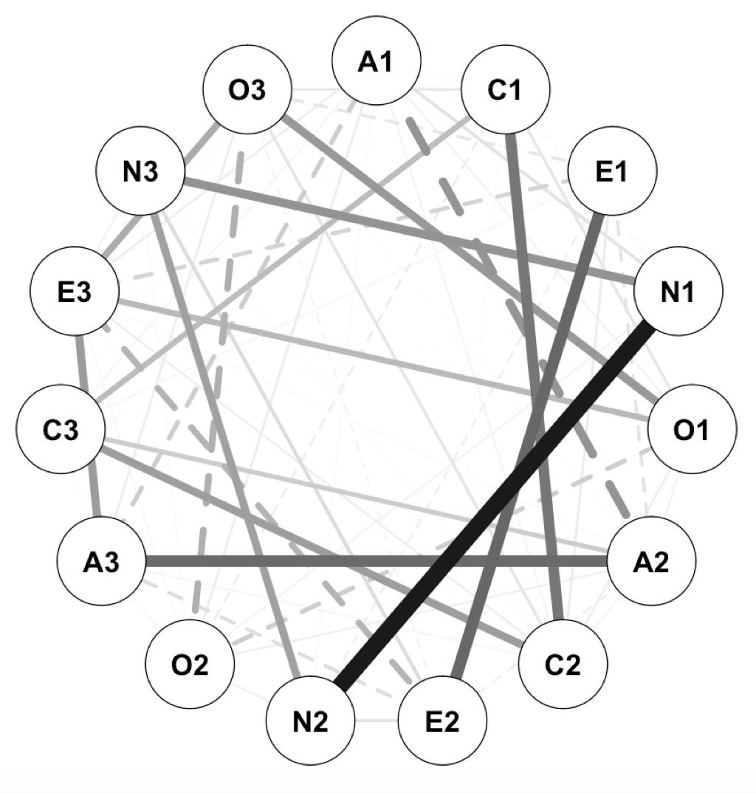
Reflective
Formative
E
A
C
N
O
E
A
C
N
O
E₁
E₂
E₃
A₁
A₂
A₃
C₁
C₂
C₃
N₁
N₂
N₃
O₁
O₂
O₃
Borsboom, Melenberg, & Van Heerden, 2003; Molenaar, 2004; Schmittman et al., 2013
Notes:
Because there is no assumption about what the latent traits are or how the indicators should relate, these relationships among the indicators can visually represented as networks.

Slide 9
Network
E
A
C
N
O
Borsboom, Melenberg, & Van Heerden, 2003; Molenaar, 2004; Schmittman et al., 2013
Notes:
Looking more closely at this formulation, there are two critical implications.

Slide 10
Formative
1
Networks are a useful frame for thinking of personality as a psychological system.
E
A
C
N
O
Borsboom, Melenberg, & Van Heerden, 2003; Molenaar, 2004; Schmittman et al., 2013
Notes:
First, if we think of personality as a system in which the latent characteristics are emergent properties of the indicators, this opens up a host of new qustions about how we think about personality measurement, change, and procceses

Slide 11
Formative
1
Networks are a useful frame for thinking of personality as a psychological system.
E
A
C
N
O
2
Causal frameworks of personality require an understanding of within-person dynamics (i.e. an idiographic approach).
Borsboom, Melenberg, & Van Heerden, 2003; Molenaar, 2004; Schmittman et al., 2013
Notes:
Second, regardless of the use of formative or reflective models under a nomothetic approach, there's currently no evidence that these between person models meet the statistical assumptions, like ergodicity, that must be met for the between person model to allow us to make causal inferences about personality at the level of a person. Only by looking at intraindividual personality structure can we begin to answer questions about the mechanisms of personality

Slide 12
Extraversion
Agreeableness
Conscientiousness
Neuroticism
Openness
Idiographic
Notes:
So, if a person-level approach is necessary for understanding the mechanisms of personality and formative, network-like models relax assumptions about independence of indicators that may not make sense at the level of a person,

Slide 13
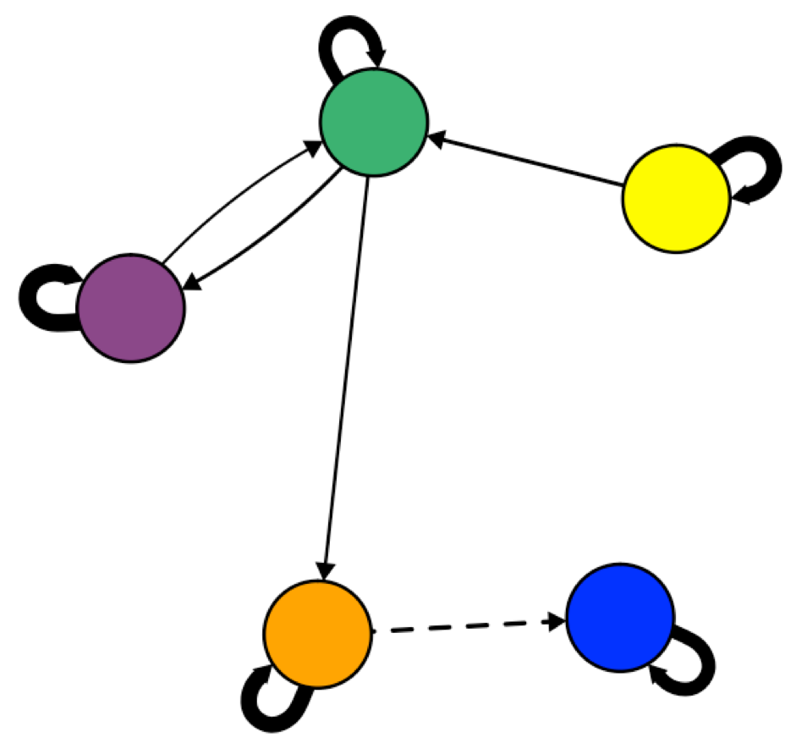
Idiographic
Notes:
Then one way of thinking about the path forward is from an idiographic network approach. Here I’ll highlight that I use the word network loosely as a stand-in for thinking about personality as a system of inputs that interact with one another over time. When we approach personality as a psychological system from the individual level across a number of people, we can start to get a better understanding of the similarity and differences in causal properties within and across people.

Slide 14
BUT
What are the nodes and edges?
Network techniques are a tool for analyzing the structure and dynamics of matrices.

Slide 15
Beck & Jackson, 2019a
Piccirillo, Beck, & Rodebaugh, 2019
P-technique
Within-Person Correlations
Within-Person Partial Correlations
Within-Person Regressions
Change as Outcome
Rates of Change
Notes:
In the paper, I’ll discuss a number of techniques for defining these nodes and edges, most of which we won’t have time to consider in depth today. However, the trick with these is that knowing different techniques for creating indicators and estimating parameters that can be represented as networks isn’t interesting in its own right. Instead, their dfinitions should be carefully matched to the questions they are meant to answer.

Slide 16
Beck & Jackson, 2019a
Walter Mischel
Raymond B Cattell
Gordon W Allport
Notes:
To find inspiration, I’ll look to some of the early key players in the study of personality, and particulary in the study of idiographic personality, as well as a few others, some of whom are in this room

Slide 17
Beck & Jackson, 2019a
Unique Structure
“Personality is the dynamic organization within an individual of those psychophysical systems” (Allport, 1937)

Slide 18
Unique Structure
“Personality is the dynamic organization within an individual of those psychophysical systems” (Allport, 1937)
P-technique
Within-Person Correlations
See Beck & Jackson (2019a,b), Molenaar (2004), Borkenau & Ostendorpf (1998), and Cattell (1947, 1957)

Slide 19
Unique Structure
“Personality is the dynamic organization within an individual of those psychophysical systems” (Allport, 1937)
P-technique
Within-Person Correlations
See Beck & Jackson (2019b), Boker (2004), Butner et al., (2014), Revelle & Condon (2015), Wilt, Bleidorn, & Revelle (2016)
Rates of Change
Traits as “form of readiness for response” (Allport, 1937, p. 293)

Slide 20
Unique Structure
“Personality is the dynamic organization within an individual of those psychophysical systems” (Allport, 1937)
P-technique
Within-Person Correlations
See Beck & Jackson (2019b), Boker (2004), Butner et al., (2014), Revelle & Condon (2015), Wilt, Bleidorn, & Revelle (2016)
Rates of Change
Traits as “form of readiness for response” (Allport, 1937, p. 293)
Change as Outcome
Rates of Change

Slide 21
Unique Structure
“Personality is the dynamic organization within an individual of those psychophysical systems” (Allport, 1937)
Trait Independence
“No trait operates alone” (Allport, 1937)
Rates of Change
Traits as “form of readiness for response” (Allport, 1937, p. 293)

Slide 22
Unique Structure
“Personality is the dynamic organization within an individual of those psychophysical systems” (Allport, 1937)
P-technique
Within-Person Correlations
Trait Independence
“No trait operates alone” (Allport, 1937)
Within-Person Partial Correlations
Within-Person Regressions
Rates of Change
Traits as “form of readiness for response” (Allport, 1937, p. 293)
Change as Outcome
Rates of Change

Slide 23
Unique Structure
“Personality is the dynamic organization within an individual of those psychophysical systems” (Allport, 1937)
P-technique
Within-Person Correlations
Trait Independence
“No trait operates alone” (Allport, 1937)
Within-Person Partial Correlations
Within-Person Regressions
Rates of Change
Traits as “form of readiness for response” (Allport, 1937, p. 293)
Change as Outcome
Rates of Change

Slide 24
Personality
Cognitive Affective
Rude
Quiet
Lazy
Relaxed
Depressed
Outgoing
Kind
Reliable
Worried
Academic Motivation
Around Others
Connected
Positive Emotion
Negative Emotion
Authenticity
Self-Esteem
Happiness
Loneliness

Slide 25
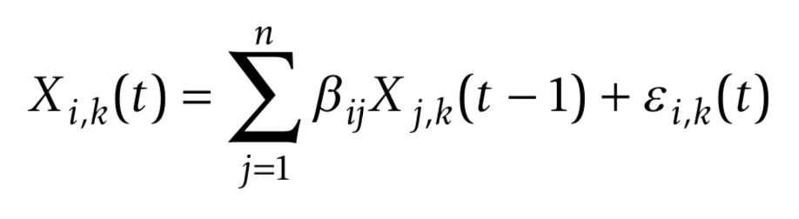
Idiographic Assessment: Graphical Autoregressive Models
k = subjects
i = item
j = item
t = assessment point
Personality
Cognitive Affective
Rude
Quiet
Lazy
Relaxed
Depressed
Outgoing
Kind
Reliable
Worried
Academic Motivation
Around Others
Connected
Positive Emotion
Negative Emotion
Authenticity
Self-Esteem
Happiness
Loneliness
Wild et al., 2010; Epskamp, Waldorp, Mõttus, & Borsboom (2018)

Slide 26
Promises | Challenges
Structure
Beck & Jackson (2017)

Slide 27
Promises | Challenges
Structure
Process
Triggering Situations
Expectancies
States /
State
Expression
Re-
Actions
Beck & Jackson (2017)

Slide 28
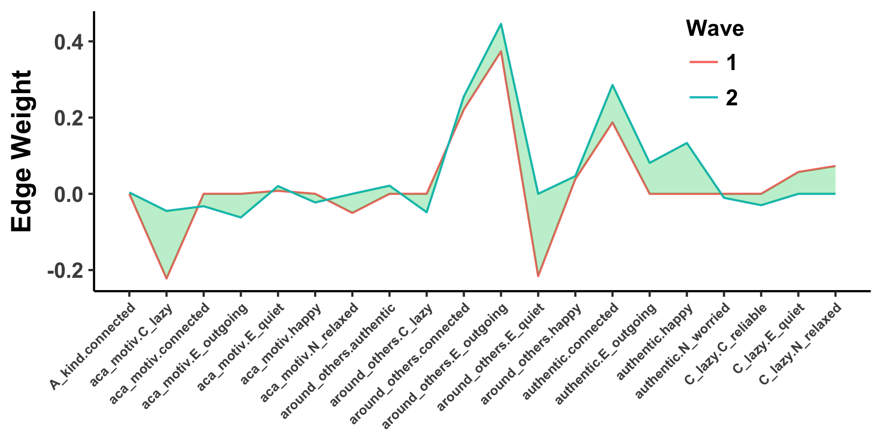
Promises | Challenges
Structure
Process
Triggering Situations
Expectancies
States /
State
Expression
Re-
Actions
Change
Beck & Jackson (2017)

Slide 29
Promises | Challenges
Structure
E
A
C
N
O
1 | 4 | 2 | 3 | 2 | 4
2 | 2 | 3 | 4 | 1 | 4
3 | 3 | 3 | 2 | 2 | 4
4 | 3 | 1 | 3 | 2 | 3
5 | 4 | 4 | 3 | 2 | 2
6 | 4 | 1 | 2 | 3 | 4
7 | 2 | 2 | 2 | 2 | 1
8 | 4 | 2 | 3 | 3 | 4
9 | 3 | 2 | 2 | 1 | 2
10 | 4 | 2 | 3 | 3 | 3
11 | 3 | 1 | 3 | 2 | 5

Slide 30
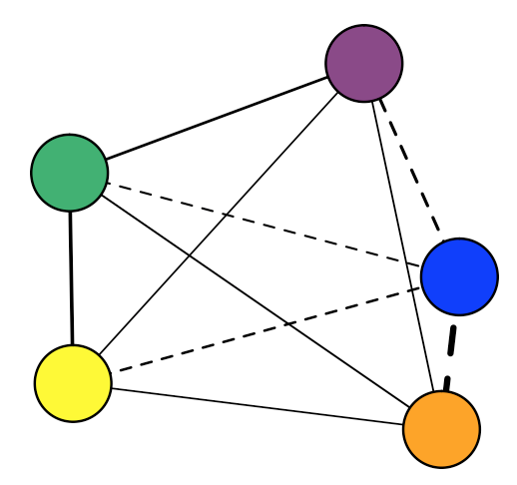
Promises | Challenges
Structure
E
A
C
N
O
1 | 4 | 2 | 3 | 2 | 4
2 | 2 | 3 | 4 | 1 | 4
3 | 3 | 3 | 2 | 2 | 4
4 | 3 | 1 | 3 | 2 | 3
5 | 4 | 4 | 3 | 2 | 2
6 | 4 | 1 | 2 | 3 | 4
7 | 2 | 2 | 2 | 2 | 1
8 | 4 | 2 | 3 | 3 | 4
9 | 3 | 2 | 2 | 1 | 2
10 | 4 | 2 | 3 | 3 | 3
11 | 3 | 1 | 3 | 2 | 5
Within Time-Points:
X_{it}←→X_{jt}

Slide 31
Promises | Challenges
Structure
Rude
Quiet
Lazy
Relaxed
Depressed
Outgoing
Kind
Reliable
Worried
Academic Motivation
Around Others
Connected
Positive Emotion
Negative Emotion
Authenticity
Self-Esteem
Happiness
Loneliness

Slide 32
Promises | Challenges
Structure

Slide 33
Promises | Challenges
Structure
Academic motivation – lazy

Slide 34
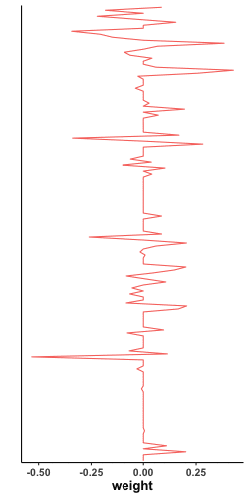
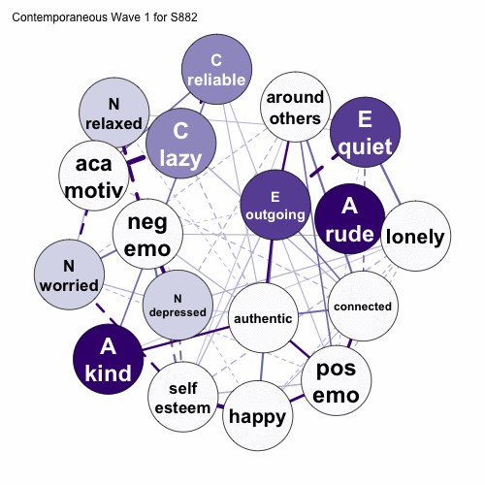
Promises | Challenges
Structure

Slide 35
Promises | Challenges
Structure

Slide 36
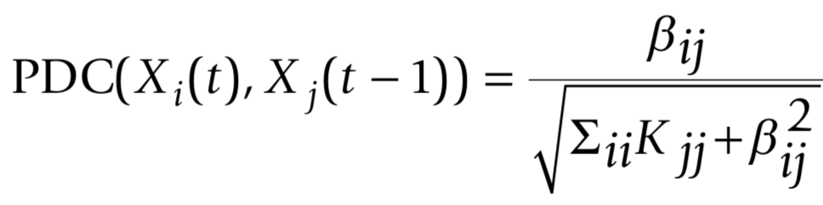
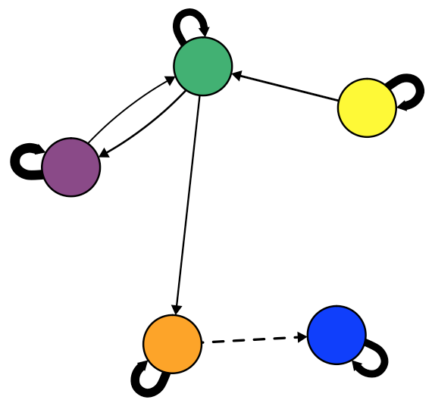
Promises | Challenges
Structure
Temporal
Contingent behaviors: If…Then…
X₁₁
X₁₂
X₁₃
. . .
X_{1j}
X₂₁
X₂₂
X_{2j}
X₃₁
X_{3j}
. . .
. . .
. . .
X_{i1}
. . .
X_{ij}
Between Time-Points:
X_{it}→X_{i, t+1}

Slide 37
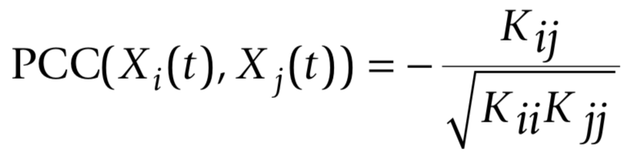
Promises | Challenges
Structure
Contemporaneous
Concurrent behaviors: While…
1
X₁₂
X₁₃
. . .
X_{1j}
X₂₁
1
X_{2j}
X₃₁
X_{3j}
. . .
. . .
. . .
X_{i1}
. . .
1
Within Time-Points:
X_{it}←→X_{jt}

Slide 38
Promises | Challenges
Personality Processes
T riggering Situations
E xpectancies
S tates /
S tate
E xpression
R e-
A ctions
Wrzus & Roberts, 2017

Slide 39
Promises | Challenges
Personality Processes
T riggering Situations
E xpectancies
S tates /
S tate
E xpression
R e-
A ctions
Wrzus & Roberts, 2017

Slide 40
Promises | Challenges
Personality Processes
T riggering Situations
E xpectancies
S tates /
S tate
E xpression
R e-
A ctions

Slide 41
Promises | Challenges
Personality Processes
Personality
Notes:
One way to think about this is to build networks with “traditional” manifestations of personality and then iteratively add single processes and examine how its addition influences the relationships among personality manifestations. So here you see a temporal personality network with 9 nodes of personality manifestations and the relationships among them.
Now, observe what happens when I add in a triggering situation

Slide 42
Promises | Challenges
Personality Processes
Personality
Personality + Triggering Situations
Notes:
And then we can add an expectancy and observe the change

Slide 43
Promises | Challenges
Personality Processes
Personality
Personality + Triggering Situations
Personality + Expectancies
Notes:
And finally we’ll add a personality state and observe the change

Slide 44
Promises | Challenges
Personality Processes
Personality
Personality + Triggering Situations
Personality + Expectancies
Personality + State Expression
Notes:
It’s a little difficult to observe the changes that happen here, so we look at the profiles of edge weights like we did before and see how adding these processes influences the relationships among the prsoanlity manifestations

Slide 45
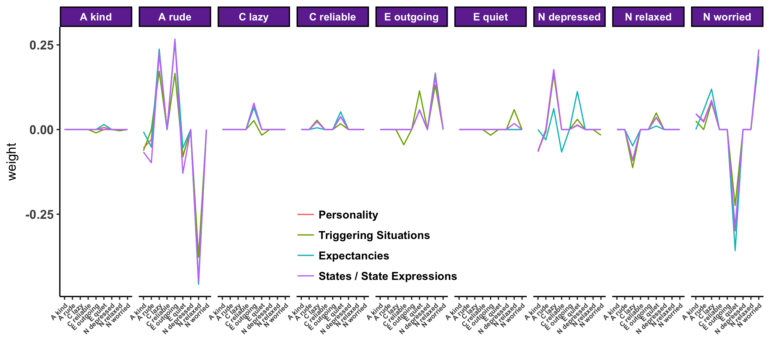
Promises | Challenges
Personality Processes

Slide 46
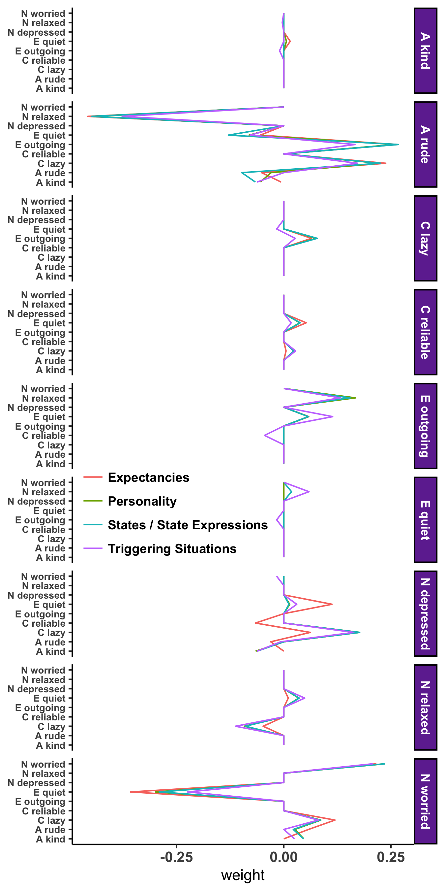
Promises | Challenges
Personality Processes
Notes:
Zooming in, we see that adding the expectancy (academic motivation) to the network, influences the relationship between current personality manifestations and future depression, with, for example a weaker positive relationship between current laziness and future depression, suggesting that academic motivation influences this if…then contingency

Slide 47
Promises | Challenges
Development
Beck & Jackson (2019)
Notes:
Consider the two networks you see here. They represent data collected from the same individual one year apart. As you can see from the profile on the right, there was some consistency in the participants’ profile over two years as evidenced by the correlation you see at the top of the profile, but there was also a large degree of change, as evidenced by the differences between the red and blue lines on the profile.

Slide 48
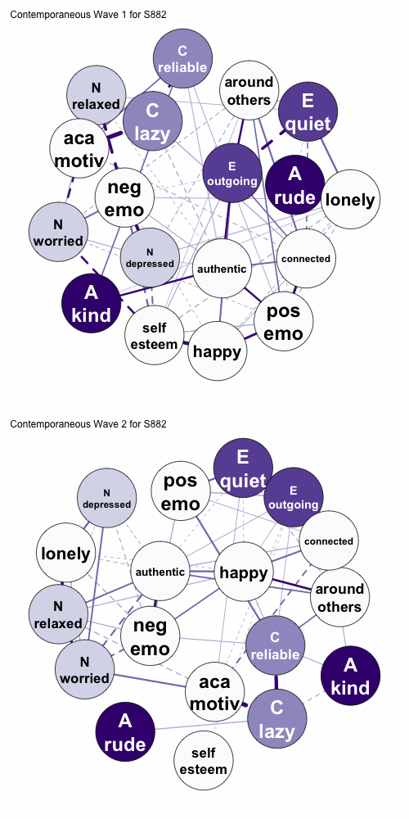
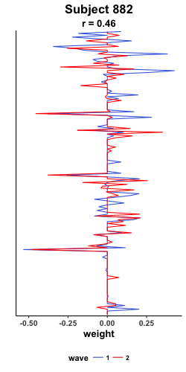
Promises | Challenges
Development
Beck & Jackson (2019)
Notes:
We can then look at this for every participant in our sample and collect the correlation of their ipsative consistency into a distribution.

Slide 49
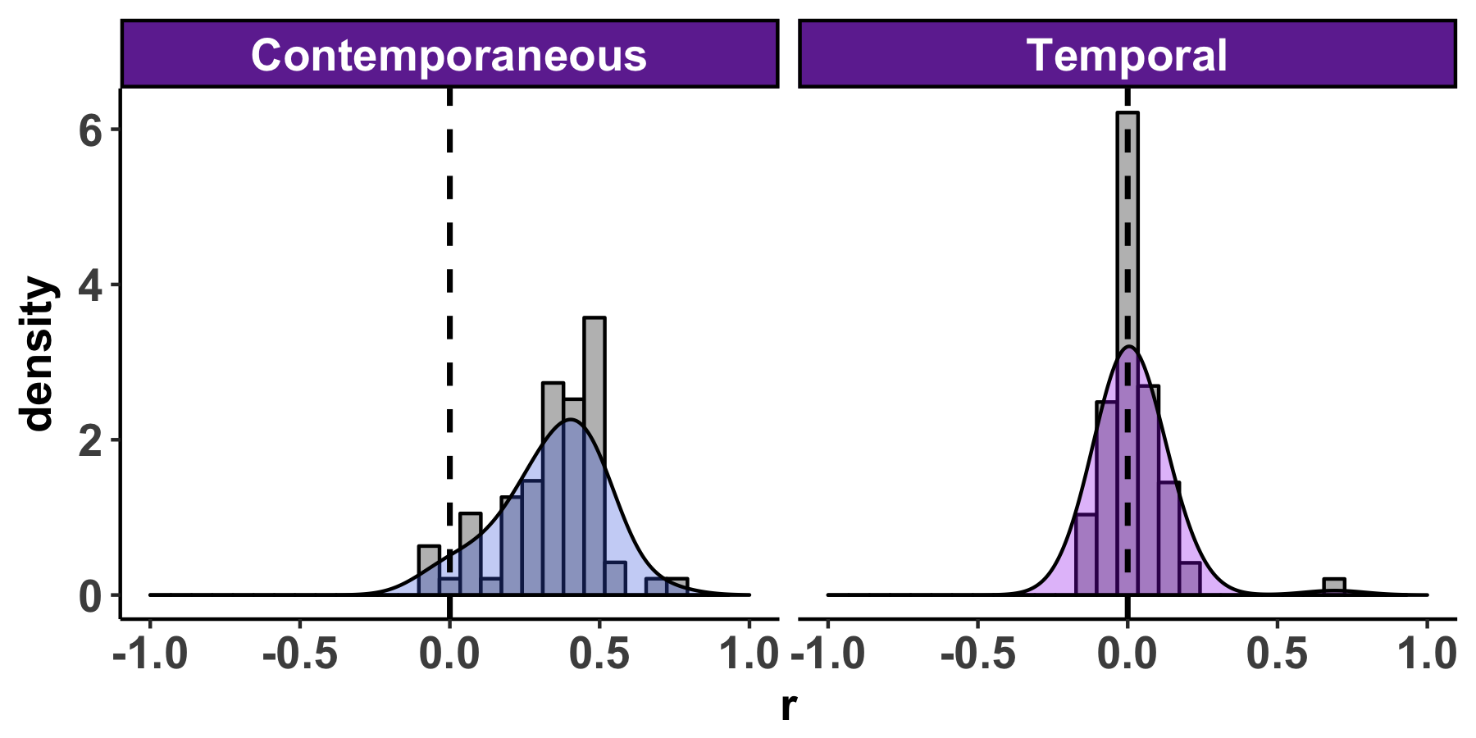
Promises | Challenges
Development
Beck & Jackson (2019)

Slide 50
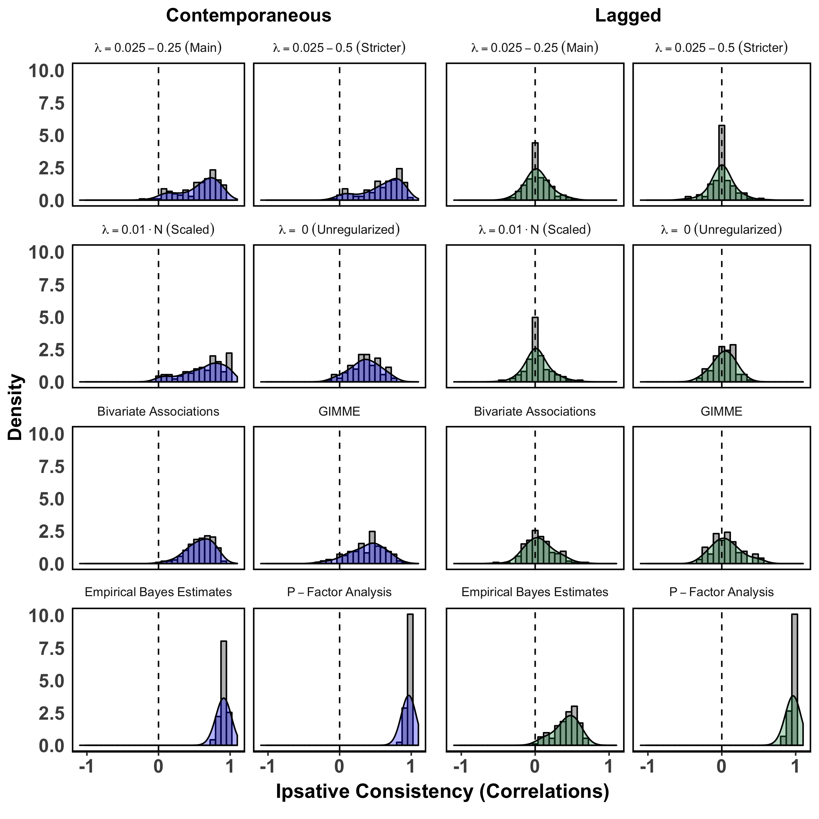
Promises | Challenges
Development
Beck & Jackson (2019)

Slide 51
Promises | Challenges
Development

Slide 52
Promises | Challenges
Piccirillo, Beck, & Rodebaugh (2019)

Slide 53
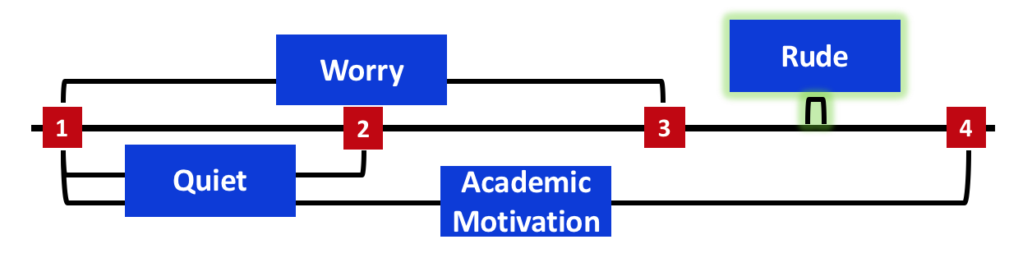
Promises | Challenges
Velocity
Piccirillo, Beck, & Rodebaugh (2019)

Slide 54
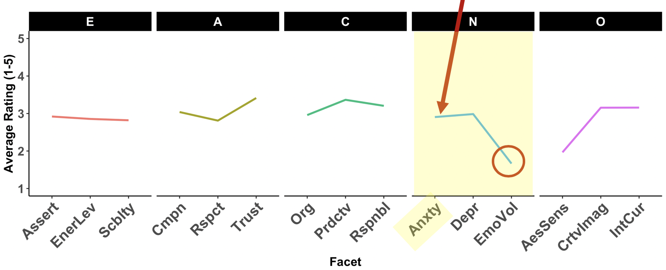
Promises | Challenges
Velocity
Psychometrics
Piccirillo, Beck, & Rodebaugh (2019)

Slide 55
Promises | Challenges
The Time Interval Problem
Psychometrics
Aggregation
Centrality
Clustering
Density
Communities
Piccirillo, Beck, & Rodebaugh (2019)

Slide 56
Promises | Challenges
The Time Interval Problem
4 hours
1
2
3
4
Worry
Academic Motivation
Quiet
Rude

Slide 57
Promises | Challenges
The Time Interval Problem
Worry
1
2
3
4
Academic Motivation
Quiet
Rude

Slide 58
Promises | Challenges
The Time Interval Problem
Worry
1
2
3
4
Quiet
Academic Motivation
Rude

Slide 59
Promises | Challenges
The Time Interval Problem
Worry
1
2
3
4
Quiet
Academic Motivation
continues
Rude

Slide 60
Promises | Challenges
The Time Interval Problem
Worry
Rude
1
2
3
4
Quiet
Academic Motivation
continues

Slide 61
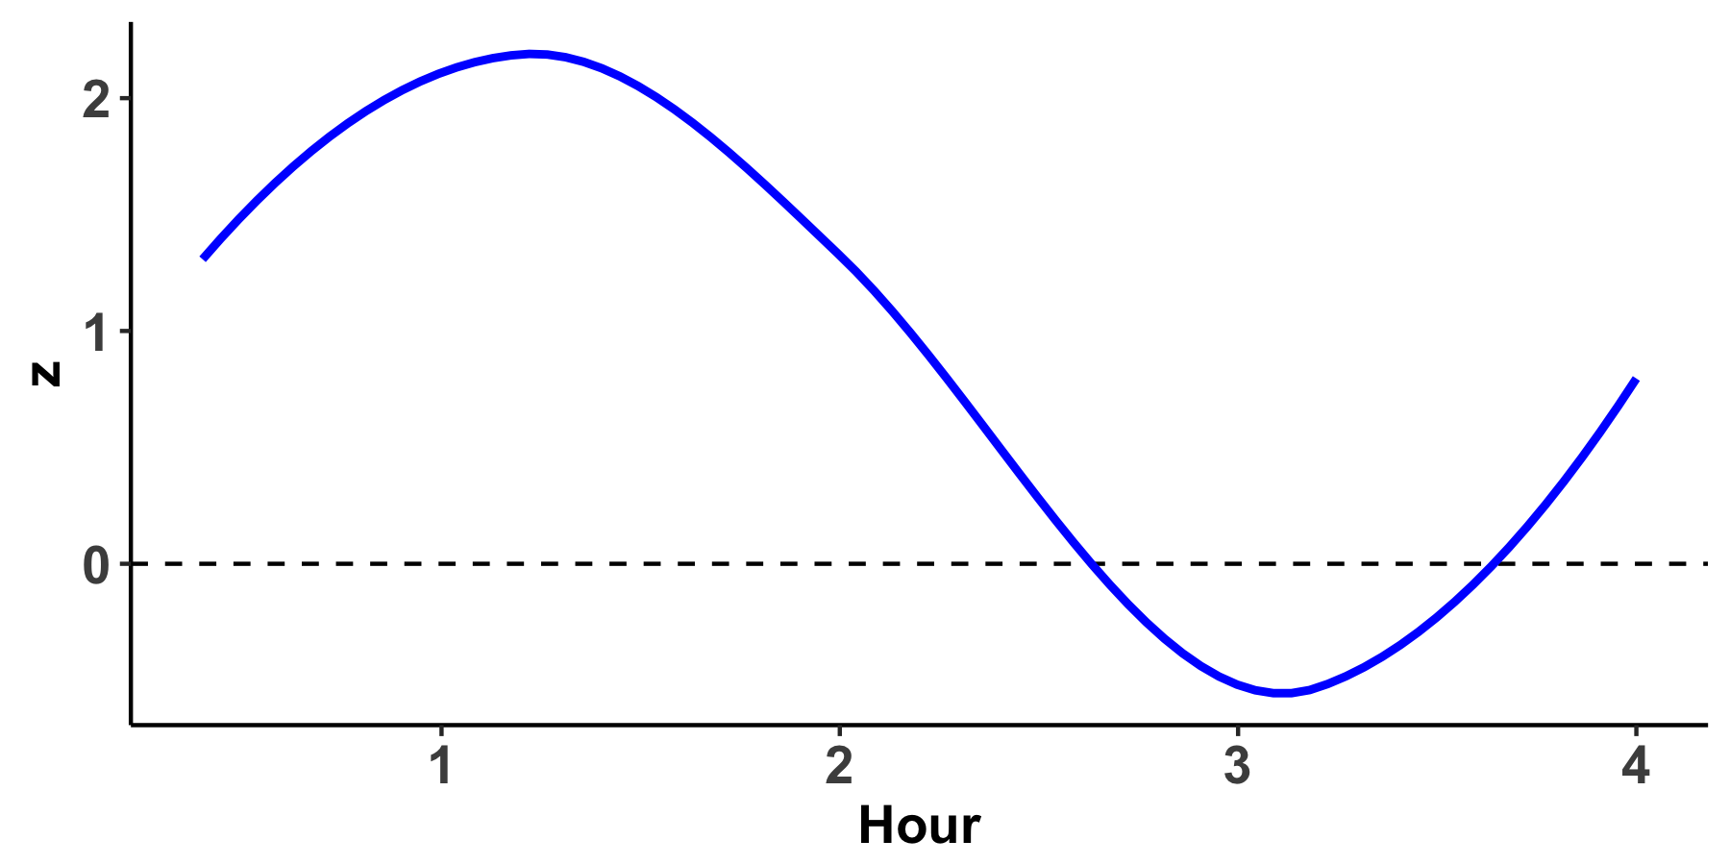
Promises | Challenges
Velocity
Worry
Rude
1
2
3
4
Quiet
Academic Motivation
continues

Slide 62
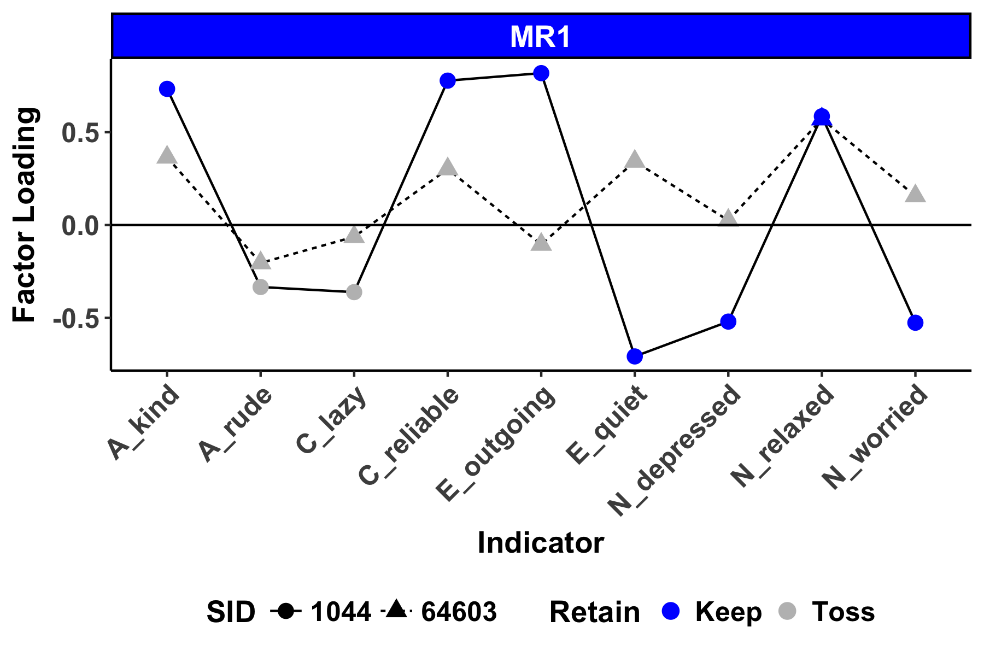
Promises | Challenges
Psychometrics
Beck & Jackson, 2019; Borkenau & Ostendorf, 1998;Molenaar, 2004

Slide 63
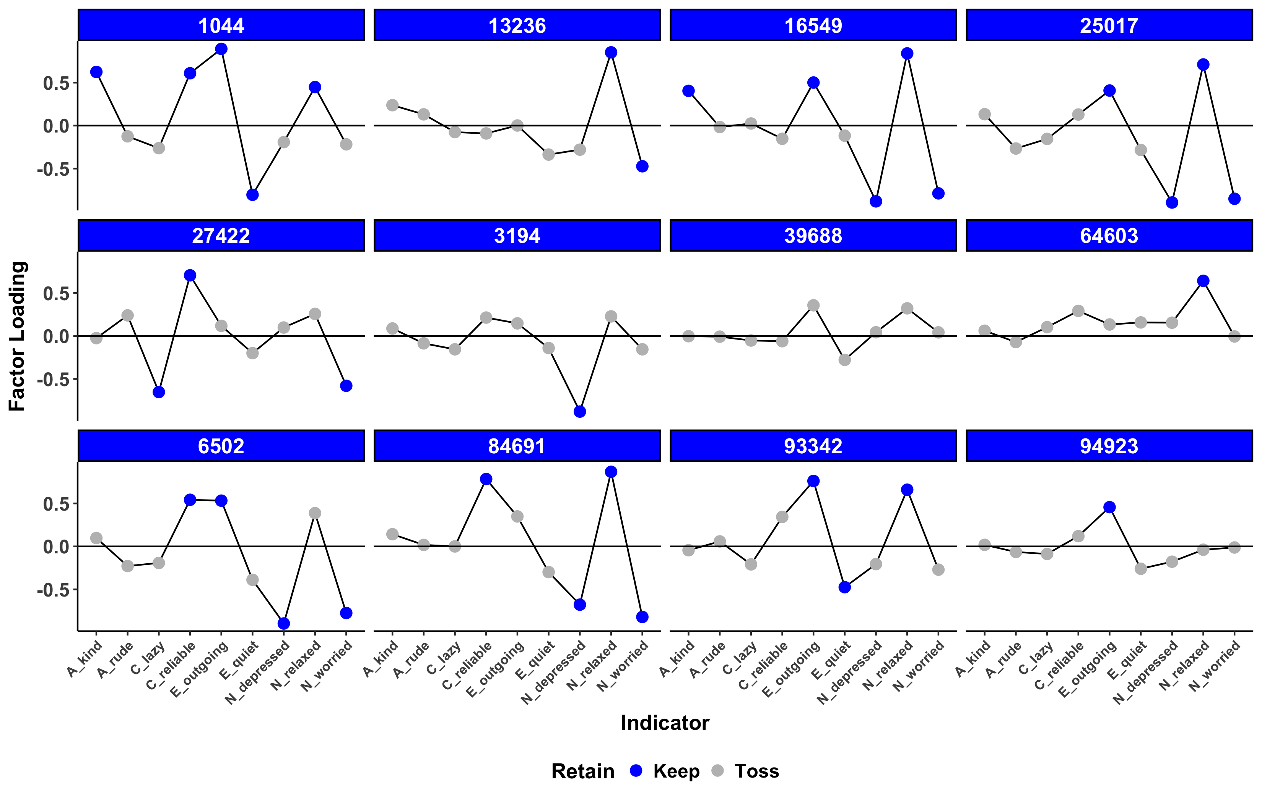
Promises | Challenges
Psychometrics

Slide 64
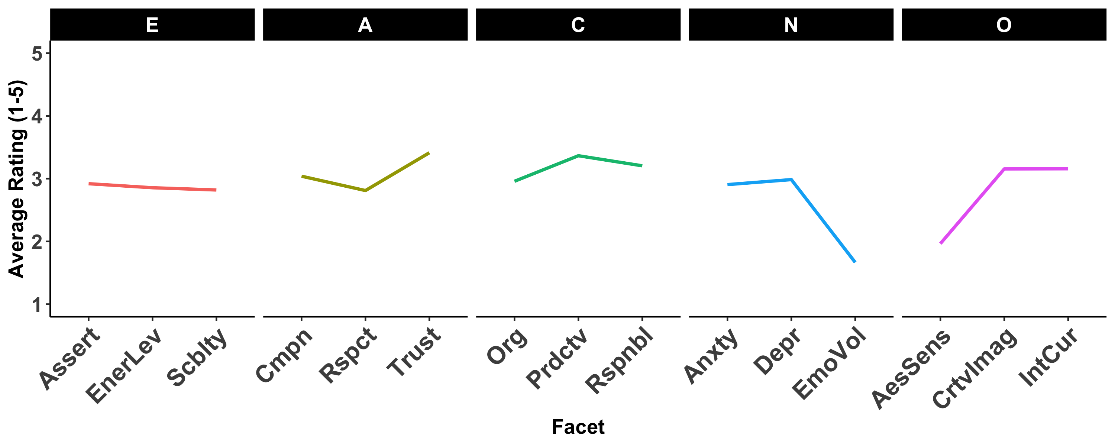
Promises | Challenges
Psychometrics
Extraversion | Agreeableness | Conscientiousness | Neuroticism | Openness
Was outgoing, sociable. | Was compassionate, had a soft heart. | Tended to be lazy. | Was relaxed, handled stress well. | Had little interest in abstract ideas.
Was talkative. | Was polite, courteous to others. | Was reliable, could always be counted on. | Worried a lot. | Was complex, a deep thinker.
Sociability | Compassion | Responsibility | Anxiety | Intellectual Curiosity
Notes:
The problem is that the items assessed typically capture a single facet of broader personality trait, which might miss facet level differences in personality. For this individual

Slide 65
Promises | Challenges
Psychometrics
Extraversion | Agreeableness | Conscientiousness | Neuroticism | Openness
Was outgoing, sociable. | Was compassionate, had a soft heart. | Tended to be lazy. | Was relaxed, handled stress well. | Had little interest in abstract ideas.
Was talkative. | Was polite, courteous to others. | Was reliable, could always be counted on. | Worried a lot. | Was complex, a deep thinker.
Sociability | Compassion | Responsibility | Anxiety | Intellectual Curiosity

Slide 66
Promises | Challenges
Psychometrics
Extraversion | Agreeableness | Conscientiousness | Neuroticism | Openness
Was outgoing, sociable. | Was compassionate, had a soft heart. | Tended to be lazy. | Was relaxed, handled stress well. | Had little interest in abstract ideas.
Was talkative. | Was polite, courteous to others. | Was reliable, could always be counted on. | Worried a lot. | Was complex, a deep thinker.
Sociability | Compassion | Responsibility | Anxiety | Intellectual Curiosity

Slide 67
Promises | Challenges
Psychometrics
Extraversion | Agreeableness | Conscientiousness | Neuroticism | Openness
Was outgoing, sociable. | Was compassionate, had a soft heart. | Was systematic, liked to keep things in order. | Was tense. | Was curious about many different things.
Was talkative. | Was helpful and unselfish with others. | Kept things neat and tidy. | Worried a lot. | Was complex, a deep thinker.
Tended to be quiet. | Felt little sympathy for others. | Tended to be disorganized. | Was relaxed, handled stress well. | Avoided intellectual, philosophical discussions.
Was sometimes shy, introverted. | Was cold and uncaring. | Left a mess, didn't clean up. | Rarely felt anxious or afraid. | Had little interest in abstract ideas.
Had an assertive personality. | Was respectful, treated others with respect. | Was efficient, got things done. | Often felt sad. | Was fascinated by art, music, or literature.
Was dominant, acted as a leader. | Was polite, courteous to others. | Was persistent, worked until the task was finished. | Tended to feel depressed, blue. | Valued art and beauty.
Found it hard to influence people. | Started arguments with others. | Tended to be lazy. | Stayed optimistic after experiencing a setback. | Had few artistic interests.
Preferred to have others take charge. | Was sometimes rude to others. | Had difficulty getting started on tasks. | Felt secure, comfortable with self. | Thought poetry and plays were boring.
Was full of energy. | Had a forgiving nature. | Was dependable, steady. | Was moody, had up and down mood swings. | Was inventive, found clever ways to do things.
Showed a lot of enthusiasm. | Assumed the best about people. | Was reliable, could always be counted on. | Was temperamental, got emotional easily. | Was original, came up with new ideas.
Rarely felt excited or eager. | Tended to find fault with others. | Was somewhat careless. | Was emotionally stable, not easily upset. | Had little creativity.
Was less active than other people. | Was suspicious of others’ intentions. | Sometimes behaved irresponsibly. | Kept their emotions under control. | Had difficulty imagining things.
Notes:
Using a planned missing data design, we collect personality data using the full BFI-2, which captures 3 facets for each of the Big 5. Participants responded to a subset of 15 items at each time point, 3 from each trait, which allows us to use ideographic multiple imputation at the facet level to impute missing data using information on responses that are subject only to that participant

Slide 68
Promises | Challenges
Aggregation

Slide 69
Promises | Challenges
Aggregation
Centrality

Slide 70
Promises | Challenges
Aggregation
Centrality
Density

Slide 71
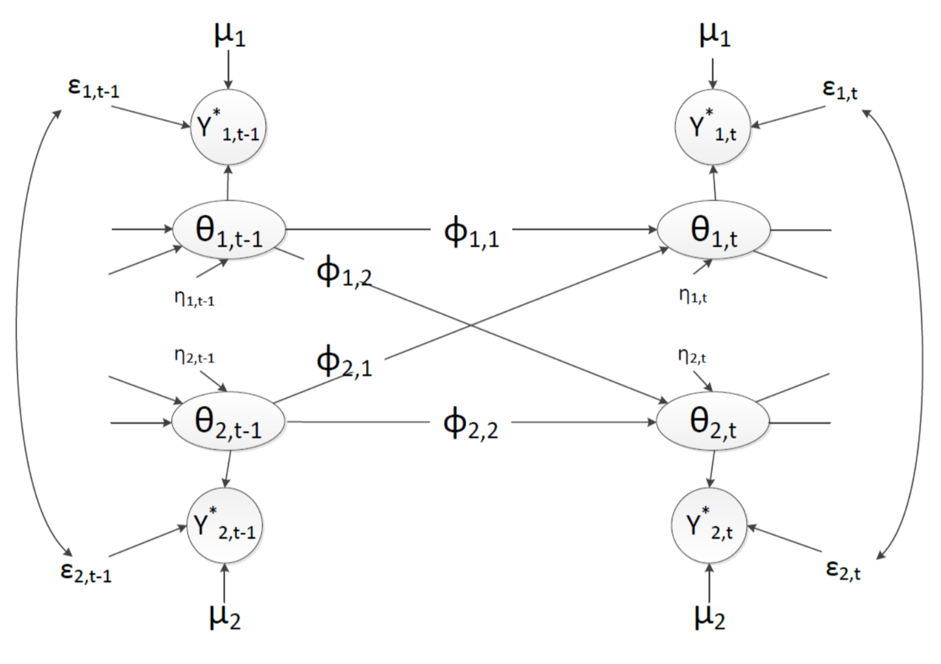
Promises | Challenges
Aggregation
Centrality
Density
Clustering
Communities
Innovation
Variability

Slide 72
Promises | Challenges
Summary
Structure
The Time Interval Problem
Process
Psychometrics
Development
Aggregation

Slide 73
Promises | Challenges
Summary
The Time Interval Problem
Process
Psychometrics
Development
Aggregation

Slide 74
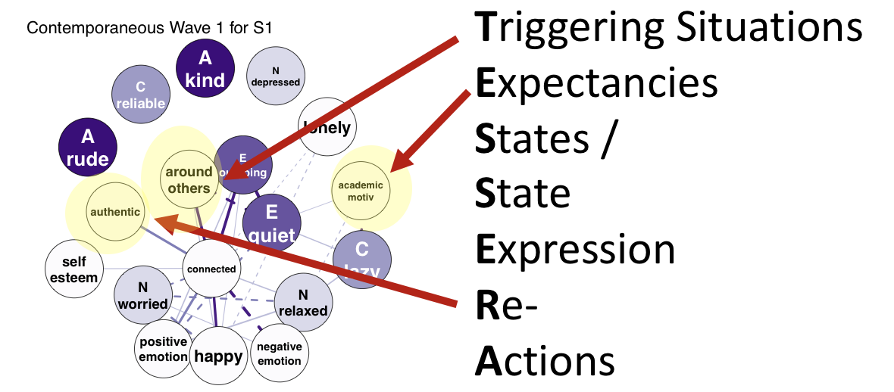
Promises | Challenges
Summary
The Time Interval Problem
Psychometrics
Development
Aggregation

Slide 75
Promises | Challenges
Summary
The Time Interval Problem
Psychometrics
Aggregation

Slide 76
Promises | Challenges
Summary
Psychometrics
Aggregation

Slide 77
Promises | Challenges
Summary
Aggregation

Slide 78
Promises | Challenges
Summary
Centrality
Clustering
Density
Communities

Slide 79
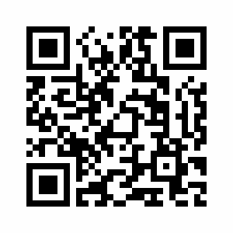
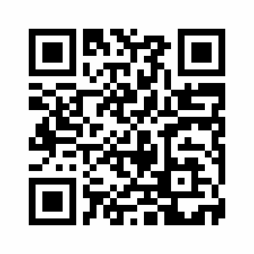
Questions?
Special Thanks to:
Josh Jackson
The PMaD Lab
(And the people who brought us PAIRS data)
Results:
https://pmdlab.wustl.edu/Beck_2019.html
Data and Code:
https://github.com/emoriebeck/APS_2018

Slide 80
The Big 5
Extraversion
Agreeableness
Conscientiousness
Neuroticism
Openness
Direction
Magnitude
--
.6 SD
1 SD
-.8 SD
.4 SD
Timing
--
Lifespan
Lifespan
10-35
10-20
Roberts, Walton, & Viechtbauer, 2006
Notes:
Personality has become more or less synonymous with the big 5
This has influenced the study of personality development and change
Pesronality changes

Slide 81
Birth of Child
Separated from Partner
Child Leaves Home
Death of Partner/Spouse
Marriage
Divorced
Leaving Parental Home
Moved in with Partner
First Job
Death of Parent
Retirement
Unemployment
E
X
X
X
X
X
X
✓
X
X
X
X
X
A
X
X
X
✓
X
X
X
X
X
X
X
X
C
X
X
X
X
X
X
X
X
X
X
X
X
N
X
X
X
X
X
X
X
X
X
X
X
X
O
X
X
X
X
X
X
X
X
X
X
X
X
Beck, Specht, Bleidorn, & Jackson (2019)
Notes:
make it more dramatic

Slide 82
Problems with
Mean-Level Change
Timing
Independence of Traits

Slide 83
Timing of Change
Schwaba & Bleidorn, 2017; Doss et al., 2009 ; Bleidorn et al., 2016

Slide 84
“No trait operates alone”
Allport, 1937, p. 330
Extraversion
Agreeableness
Conscientiousness
Neuroticism
Openness
“Personality is the dynamic organization within the individual of those psychophysical systems that determine his unique adjustments to his environment”

Slide 85
“No trait operates alone”
Allport, 1937, p. 330
Extraversion
Conscientiousness
Agreeableness
Neuroticism
Openness

Slide 86
“No trait operates alone”
Allport, 1937, p. 330
Extraversion
Conscientiousness
Agreeableness
Neuroticism
Openness

Slide 87
“No trait operates alone”
Allport, 1937, p. 330
Extraversion
Extraversion
Conscientiousness
Agreeableness
Conscientiousness
Agreeableness
Neuroticism
Openness
Neuroticism
Openness

Slide 88
“No trait operates alone”
Allport, 1937, p. 330
Extraversion
Extraversion
Conscientiousness
Agreeableness
Conscientiousness
Agreeableness
Neuroticism
Openness
Neuroticism
Openness

Slide 89
“No trait operates alone”
Allport, 1937, p. 330
Extraversion
Extraversion
Conscientiousness
Agreeableness
Conscientiousness
Agreeableness
Neuroticism
Openness
Neuroticism
Openness

Slide 90

Promises | Challenges
Development
Notes:
A recent paper in nature proposed a permutation based kernel change point procedure for detecting reliable correlational changes in a psychological system.

Slide 91
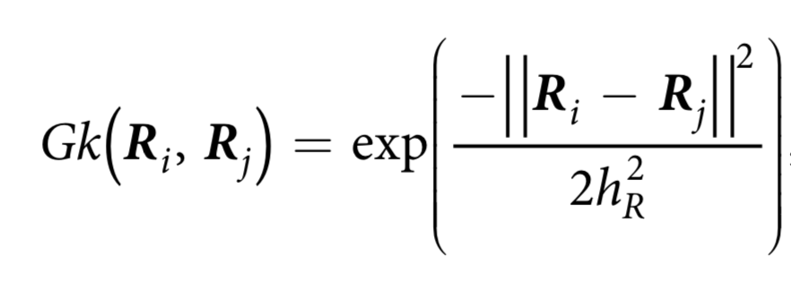
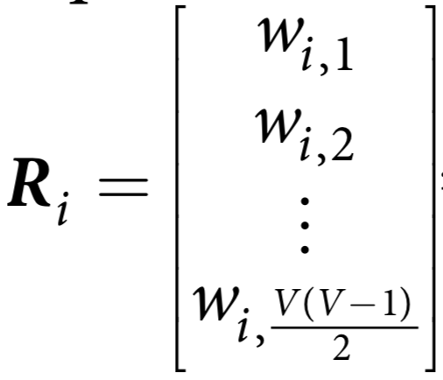
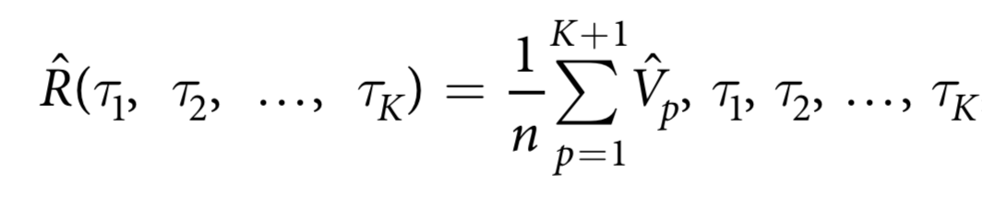
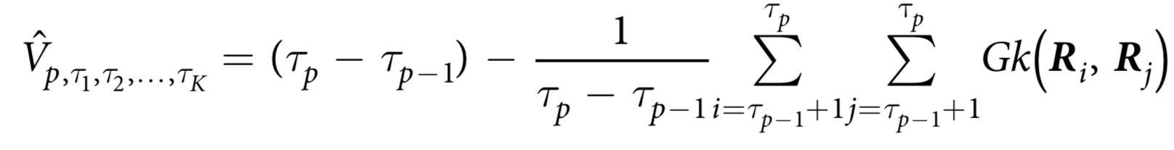
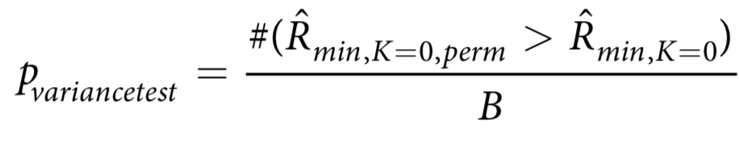
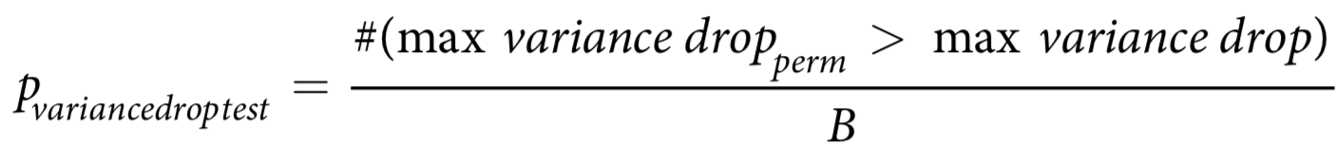
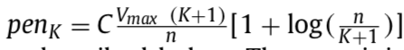
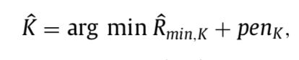
1
Moving Window Correlations
Gaussian Similarity between all
possible phases for different k
2
3
Calculate average within-phase
Variance of Gaussian Similarity
Repeat steps 1 and 2 for 1000
permuted data sets
4
Perform the variance test
5
Perform the variance drop test
6
Declare significance if either the
variance or variance drop tests passes
7
Keep k of minimum penalized
average within-phase variance
8
Preregistration: https://osf.io/mfn8w/
Notes:
Not going to get into the details, but basically, the KCP procedure is going to leverage the gaussian similarity between the correlations of different windows to test whether the variance of those correlations between two points is greater than what we would expect if the time series was randomly ordered.

Slide 92
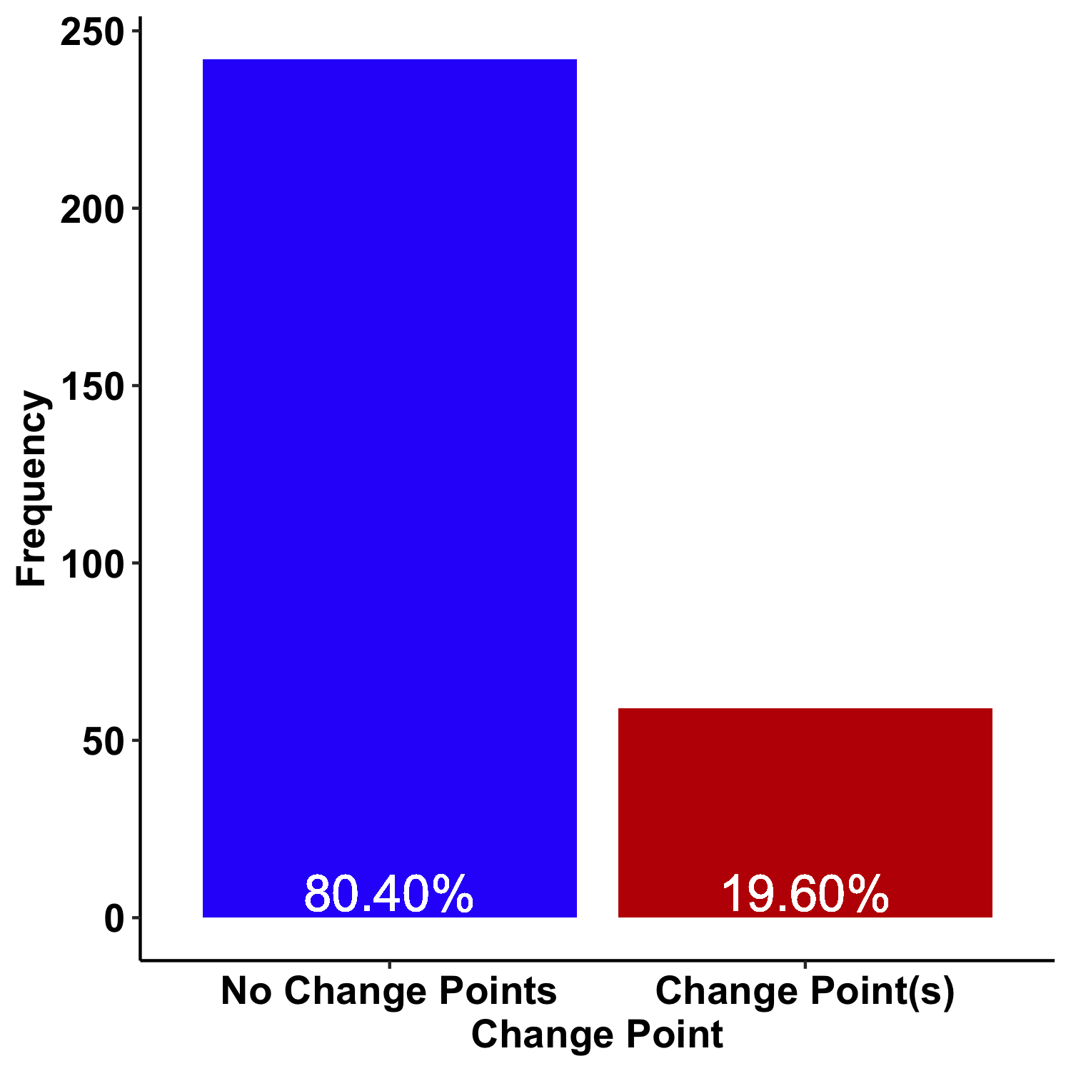
Did people show correlational changes?

Slide 93
Where were there correlational changes?

Slide 94
Where were there correlational changes?

Slide 95
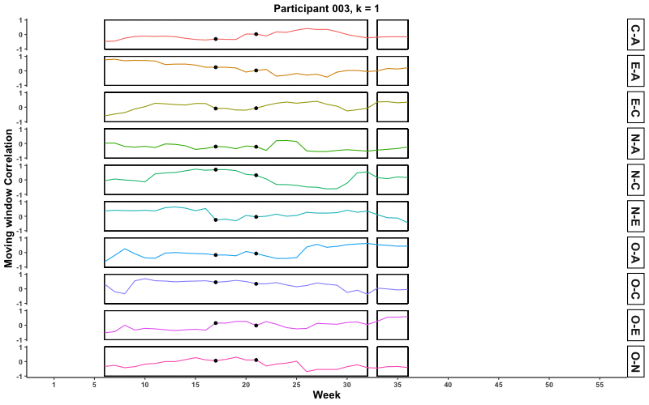
Where were there correlational changes?

Slide 96
Where were there correlational changes?

Slide 97
Promises | Challenges
Aggregation

Slide 98
Promises | Challenges
Aggregation
Centrality

Slide 99
Promises | Challenges
Aggregation
Centrality
Density

Slide 100
Promises | Challenges
Aggregation
Centrality
Density
Clustering
Communities
Innovation
Variability

Slide 102
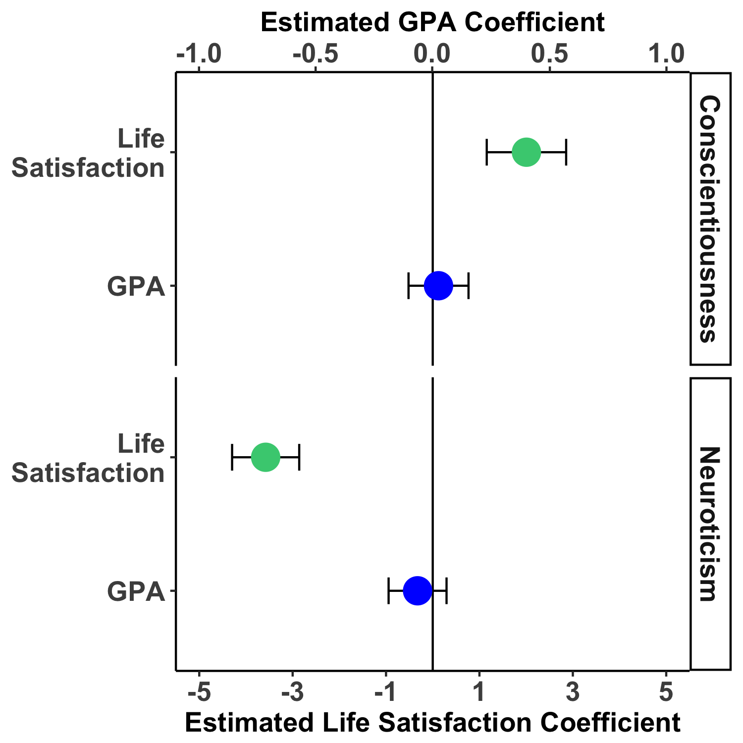
Composites | Centrality | Density
Notes:
First, before we consider the results of the networks, I think it’s useful to understand how conscientiousness and neuroticism composites of ESM measures relate to our outcomes of interest in this data set. In the figure, the outcomes are on the y axis, the estimated regression coefficients estimating each outcome from each trait is on the x axis, and conscientiousness and neuroticism are represented in separate panels.
In this sample, both conscientiousness and neuroticism predicted life satisfaction, with higher conscientiousness predicting higher life satisfaction and higher neuroticism predicting lower life satisfaction. Neither conscientiousness nor neuroticism were significant predictors of GPA.

Slide 103
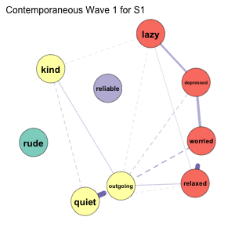
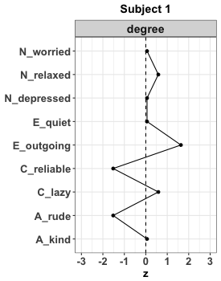
Notes:
Now, I want to briefly show you the network results to highlight the differences in network structure and the degree centrality of the nodes.

Slide 104
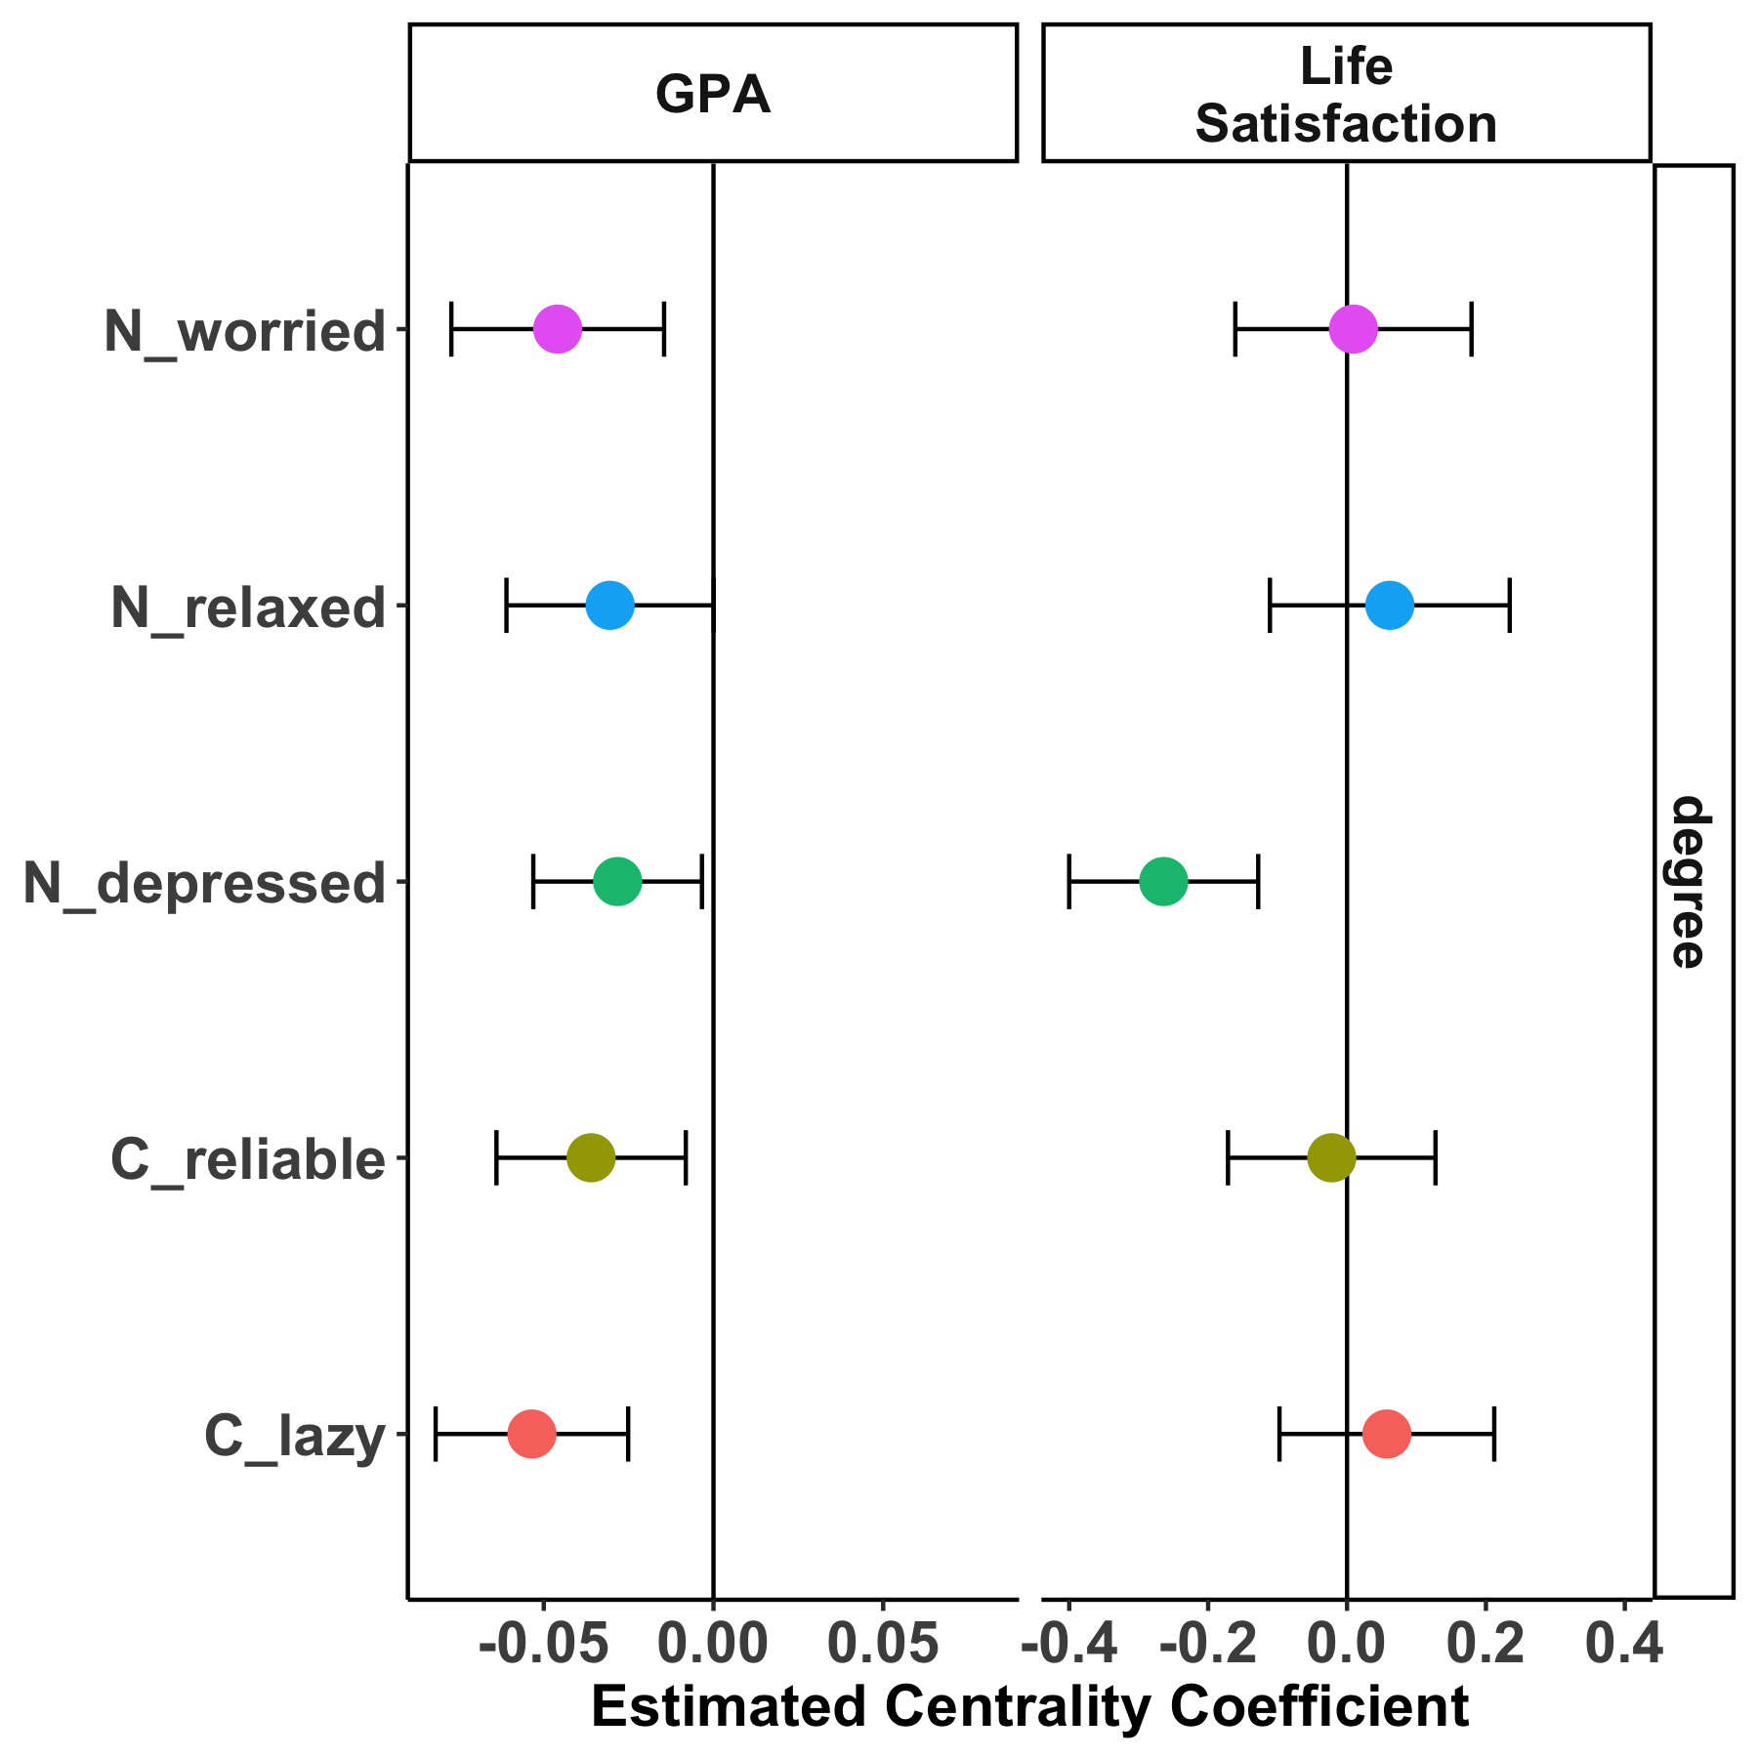
Composites | Centrality | Density
5
3
3
5
1
1
Notes:
Next, I am going to show you the results of a series of regression models predicting GPA and life satisfaction from the degree centrality of the conscientiousness and neuroticism nodes.
As a reminder, degree centrality is a marker the relative importance of nodes in a network, so it’s telling us how the importance of a specific behavior to an individual is related to life satisfaction and GPA.
First, for GPA, we see that the degree centrality of many of the nodes is negatively related to GPA. That is, the more connected a node is to other nodes, the lower that individual reported his or her GPA to be. The relationship between the degree centrality and GPA is particularly striking given that ESM composites of Conscientiousness and Neuroticism did not.
For life satisfaction, only the degree centrality of the depressed node significantly predicted life satisfaction. As with GPA, the more connected the depressed node, the lower individuals tended to rate their life satisfaction. Although the Neuroticism ESM composite did predict life satisfaction, using degree centrality suggests that it is the dynamics of feelings of depression, not relaxation or worry, that are related to life satisfaction.

Slide 105
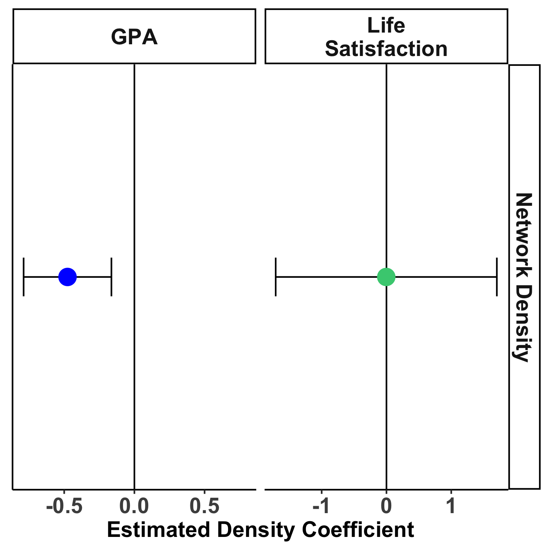
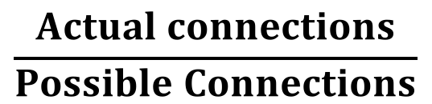
Composites | Centrality | Density
.48
.31
.14
$$\frac{Actual connections}{Possible Connections}$$
Notes:
Moving on to density, I’ll remind you that density is a global property, indexing the number of actual connections in a network relative to the number of possible connections. As such, I ran only one regression for each outcome, using density as the predictor.
GPA was negatively related to density – that is, more densely connected networks were related to lower GPA. In other words, the more and stronger connections between individuals behavior tended to be, the worse they tended to perform academically. Again, such a pattern is striking because ESM composites did not predict GPA.
In contrast, density did not predict life satisfaction – that is, the connectedness of individuals’ networks did not seem to be related to life satifaction.

Slide 106
Low Density, Degree
High Density, Degree
Notes:
Network scientists have long believed that a more connected network is not necessarily better. Indeed, in network science, a saturated network represents chaos because the system becomes vulnerable to external events. That is – small pertrubations or changes in one part of the system can have strong cascading effects. On the other hand, networks with only a small number of links between node are considered rigid because the pathway of influence of nodes is extremely limited. Most networks fall somewhere in between.
For example, look at these two networks from the sample. The network on the right has many strong connections – it is a dense network in which many nodes are also high in degree centrality. Thus, tossing this person into a social situation that pushes him or her to be more outgoing (E2) will quickly impact how quiet, lazy, worried, and depressed they were, which in turn, given the strength of the connections will be likely to impact many other behaviors. The network on the left, in contrast, suggests a predictable pattern when the participant is placed into a situation that requires him or her to be more outgoing. He or she would be less quiet and less worried, but we are unlikely to see gross changes in other personality manifestations.

Slide 107
Contemporaneous
Concurrent behaviors: While…
E
A
C
N
O
E
A
C
N
O
time
1 | 4 | 2 | 3 | 2 | 4
2 | 2 | 3 | 4 | 1 | 4
3 | 3 | 3 | 2 | 2 | 4
4 | 3 | 1 | 3 | 2 | 3
5 | 4 | 4 | 3 | 2 | 2
6 | 4 | 1 | 2 | 3 | 4
7 | 2 | 2 | 2 | 2 | 1
8 | 4 | 2 | 3 | 3 | 4
9 | 3 | 2 | 2 | 1 | 2
10 | 4 | 2 | 3 | 3 | 3
11 | 3 | 1 | 3 | 2 | 5
E
0.02
-0.05 | 0.08
0.64 | -0.12 | -0.10
0.26 | -0.27 | 0.43 | 0.07
A
C
N
O
Within Time-Points:
X_{it}←→X_{jt}
Notes:
Experience sampling data are also called multivariate time series data. Essentially, you end up with a data matrix that looks like this, where instead of each row indicating responses from a different individual, the rows indicate momentary observations from a single individual on a numbe rof trait constructs.
Much as how we can look at how trait constructs are related to one another across people, these data allow us to ask how they are related within a person idiographically.

Slide 108
Contemporaneous
Concurrent behaviors: While…
E
A
C
N
O
1 | 4 | 2 | 3 | 2 | 4
2 | 2 | 3 | 4 | 1 | 4
3 | 3 | 3 | 2 | 2 | 4
4 | 3 | 1 | 3 | 2 | 3
5 | 4 | 4 | 3 | 2 | 2
6 | 4 | 1 | 2 | 3 | 4
7 | 2 | 2 | 2 | 2 | 1
8 | 4 | 2 | 3 | 3 | 4
9 | 3 | 2 | 2 | 1 | 2
10 | 4 | 2 | 3 | 3 | 3
11 | 3 | 1 | 3 | 2 | 5
Within Time-Points:
X_{it}←→X_{jt}
Notes:
And these correlations can be visualized as networks, whose properties can be analyzed to tell us something about the structure of individual differences

Slide 109
Idiographic
Notes:
But network models have great potential in personality. When coupled with intensive longitudinal data collection, such as that collected using experience sampling or daily diary measures, network models can also be created for individual people, allowing for unique interdependencies among responses.
Such an approach has the advantage of allowing us to model personality closer to the level of a person. In other words, we can model unique relationships among the individuals self-reported observable and unobservable experiences, which may finally allow us to answer the question of whether idiographic assessments of personality do stack up to the power of nomothetic assessments.

Slide 110
Personalized Interventions
procrastination
energy
Notes:
Moreover, in the study of momentary measures of personality, we can introduce other measures of behavior and assess how those manifestations relate to personality. For example, if we are interested in changing someone’s procrastination, we note a strong, negative connection between energy levels and procrastination such that this individual tends to report low energy while procrastintating.
Noting unique connections like this between target behaviors and personality allows for the use of targeted strategies for changing a behavior

Slide 111

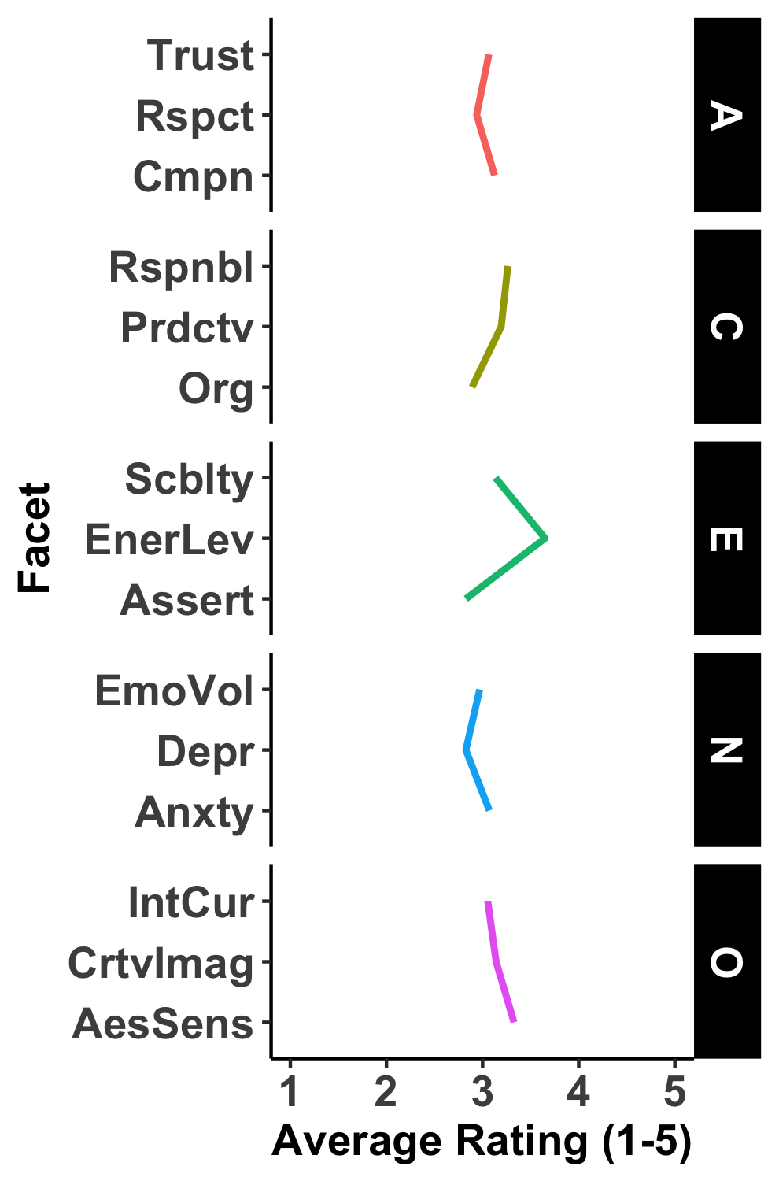


Personalized Interventions
Phase 1:
ESM
Phase 2:
Modeling
Phase 3:
Intervention
Phase 4:
ESM
Phase 5:
ESM
Relaxed, calm
Outgoing, sociable
Was lazy
Was forgiving
Relaxed, calm
Outgoing, sociable
Was lazy
Was forgiving
Relaxed, calm
Outgoing, sociable
Was lazy
Was forgiving
From: PMaD Lab
Feeling tired? Try taking a walk!
Traditional Approach: Personality Profiles
(More of a trait is good/bad)
Notes:
More typically in personality intervention studies, one might look at the profile of nomothetic personality traits where having more a of trait is seen as a good or bad and the goal is to increase the levels of a trait in the hopes of changing a behavior. That is, if we make someone more Conscientious, then they should procrastinate less.
In this study, we had a five phase design, where participants completed baseline surveys and a first wave of ESM surveys, received feedback on their personality, underwent an intervention, then completed. Two more waves of ESM surveys. Some participants received feedback based on their personality trait profile,

Slide 112
Personalized Interventions
Phase 1:
ESM
Phase 2:
Modeling
Phase 3:
Intervention
Phase 4:
ESM
Phase 5:
ESM
Relaxed, calm
Outgoing, sociable
Was lazy
Was forgiving
Relaxed, calm
Outgoing, sociable
Was lazy
Was forgiving
Relaxed, calm
Outgoing, sociable
Was lazy
Was forgiving
From: PMaD Lab
Feeling tired? Try taking a walk!
Our Approach: Idiographic Network Profiles
(Specific Personality-Behavior links good/bad)
Notes:
While others received feedback based on the contemporaneous relationships between procrastination or loneliness and facet-level manifesatations of state personality. In our approach, rather than levels of a trait being good or bad, specific links between personality and behavior were “good or bad”

Slide 113
Target Behavior
Procrastination
Loneliness
Trait
Feedback
Network
Notes:
Ultimately we had a 2x2 design where we

Slide 114
1: ESM | 2: Modeling | 3: Intervention | 4: ESM | 5: ESM
Edges
Notes:
So here’s an example of the resulting model for a single participant. To look at structure, it also useful to look at the relationships as a profile of the edges or relationships.

Slide 115
1: ESM | 2: Modeling | 3: Intervention | 4: ESM | 5: ESM
Personality-Personality
Procrastination-Personality
Notes:
Moreover, we can break these down in to the focal relationships that are between personality manifestations and target beahvios, which are highlighted in yellow and those between two different personality manifestations

Slide 116
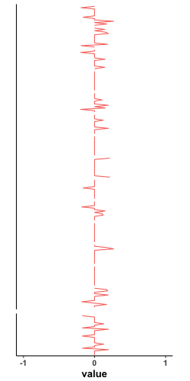
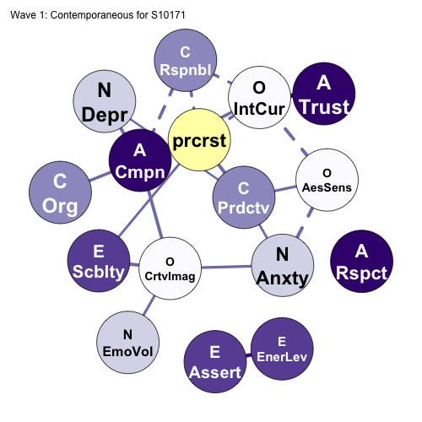
1: ESM | 2: Modeling | 3: Intervention | 4: ESM | 5: ESM
Personality-Personality
Procrastination-Personality
Notes:
We can then look at these for a bunch of different participants
And we start to see a lot of individual differences

Slide 117
1: ESM | 2: Modeling | 3: Intervention | 4: ESM | 5: ESM
Personality-Personality
Procrastination-Personality
Notes:
INDIVIDUAL DIFFERENCES

Slide 118
1: ESM | 2: Modeling | 3: Intervention | 4: ESM | 5: ESM
Notes:
Next we take the informatin from these models and give the particiapnts feedback on their personality using a dashboard style format

Slide 119

1: ESM | 2: Modeling | 3: Intervention | 4: ESM | 5: ESM
Notes:
This is what particiapnts see on the home page of their multi-tab report. It provides basic information about percentiles, etc of their personality

Slide 120
1: ESM | 2: Modeling | 3: Intervention | 4: ESM | 5: ESM
Behavior-Personality Link
Personalized Strategy
E
EnerLev
Take a walk.
prcrst
N
Anxty
Log distracting thoughts.
Notes:
But it also leverages those behavior personality links

Slide 121
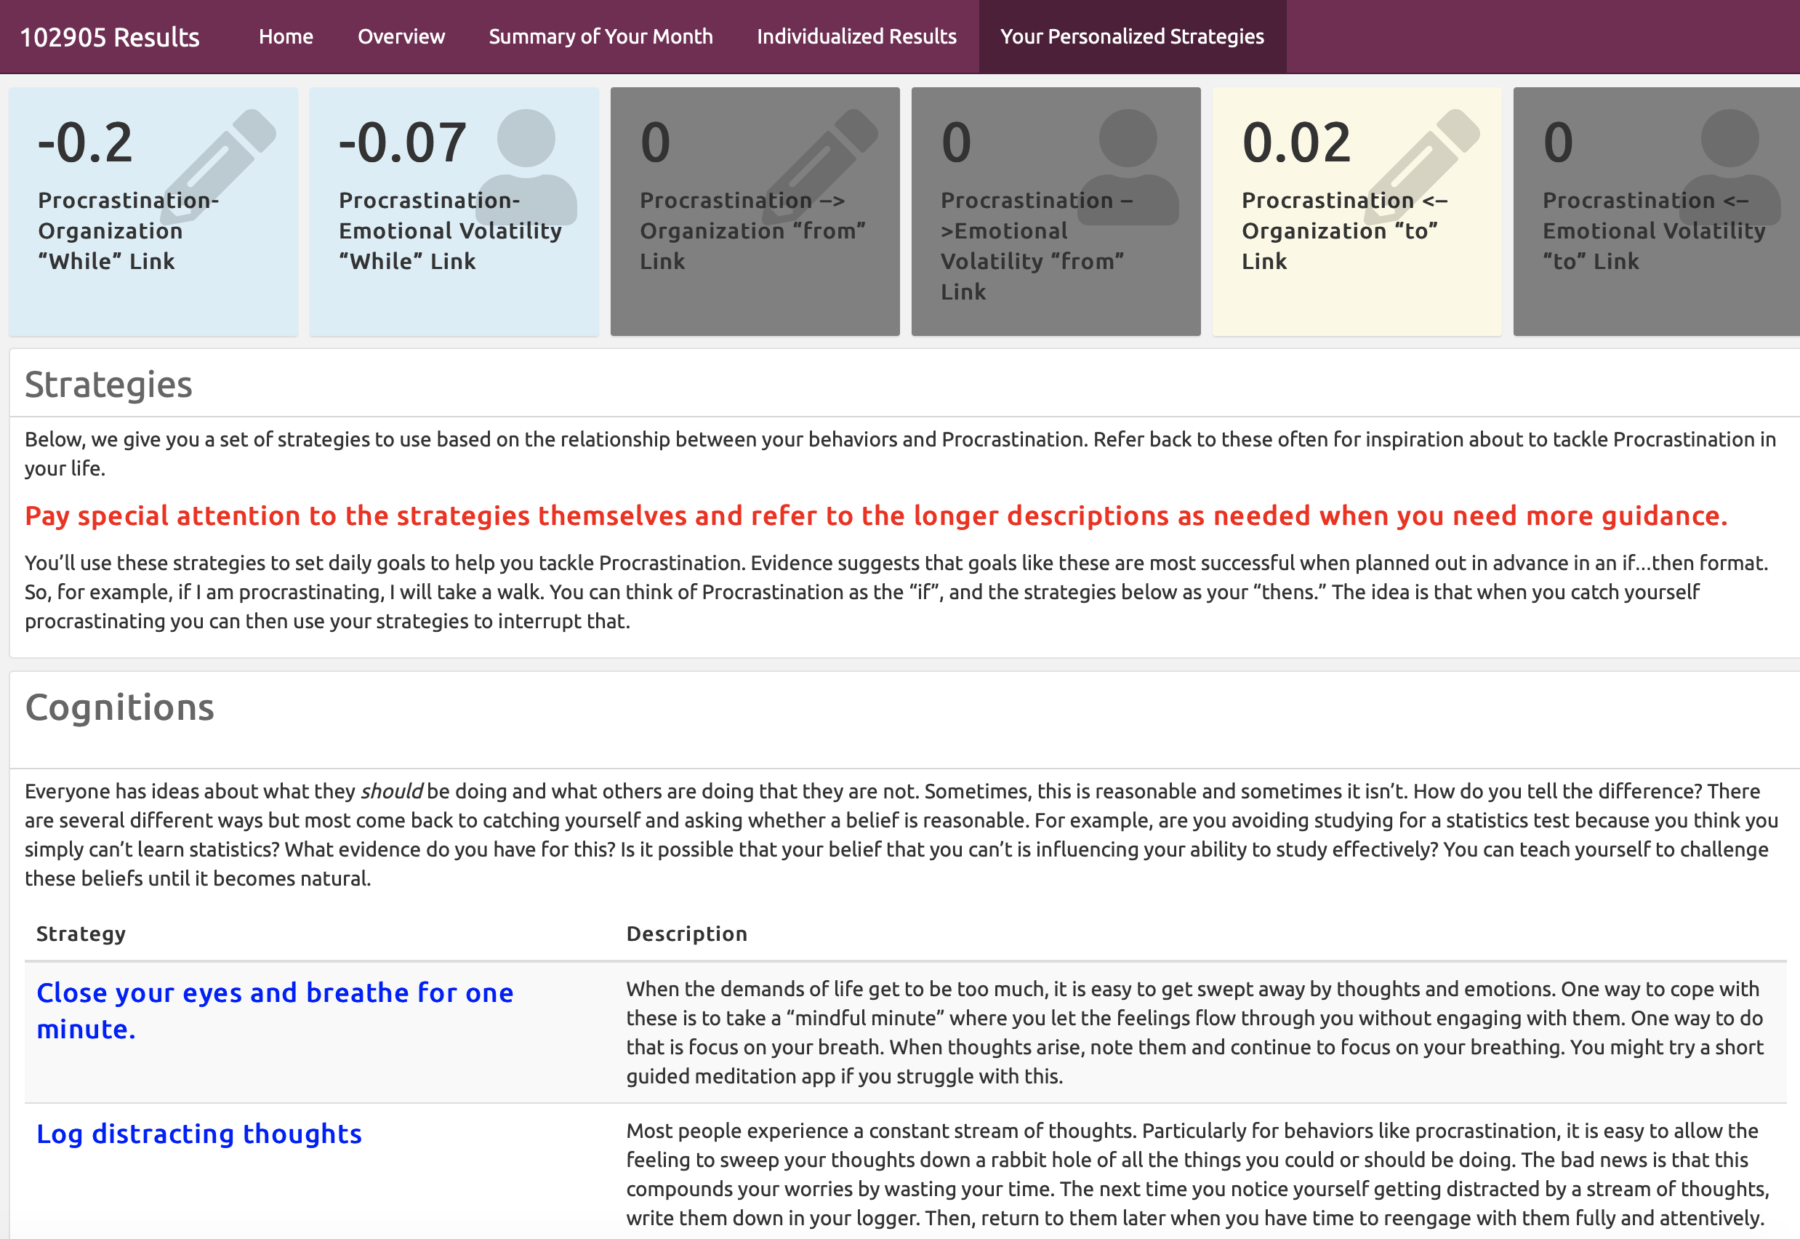

1: ESM | 2: Modeling | 3: Intervention | 4: ESM | 5: ESM
Notes:
The feedback page looks something like this. For example, for this participant, they show anegative link between Porcrastination and emotional volatility, so we suggest that they take a minute to breathe when they find themselves procrastinating

Slide 122
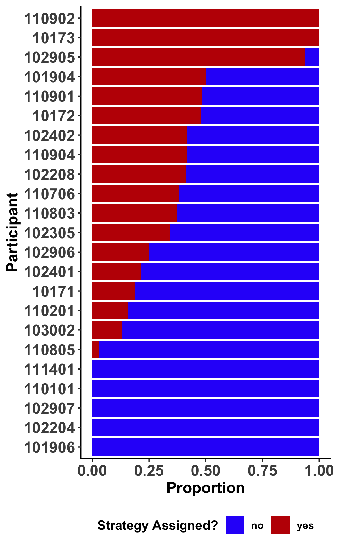
1: ESM | 2: Modeling | 3: Intervention | 4: ESM | 5: ESM
Did participants use their assigned strategies?

Slide 123
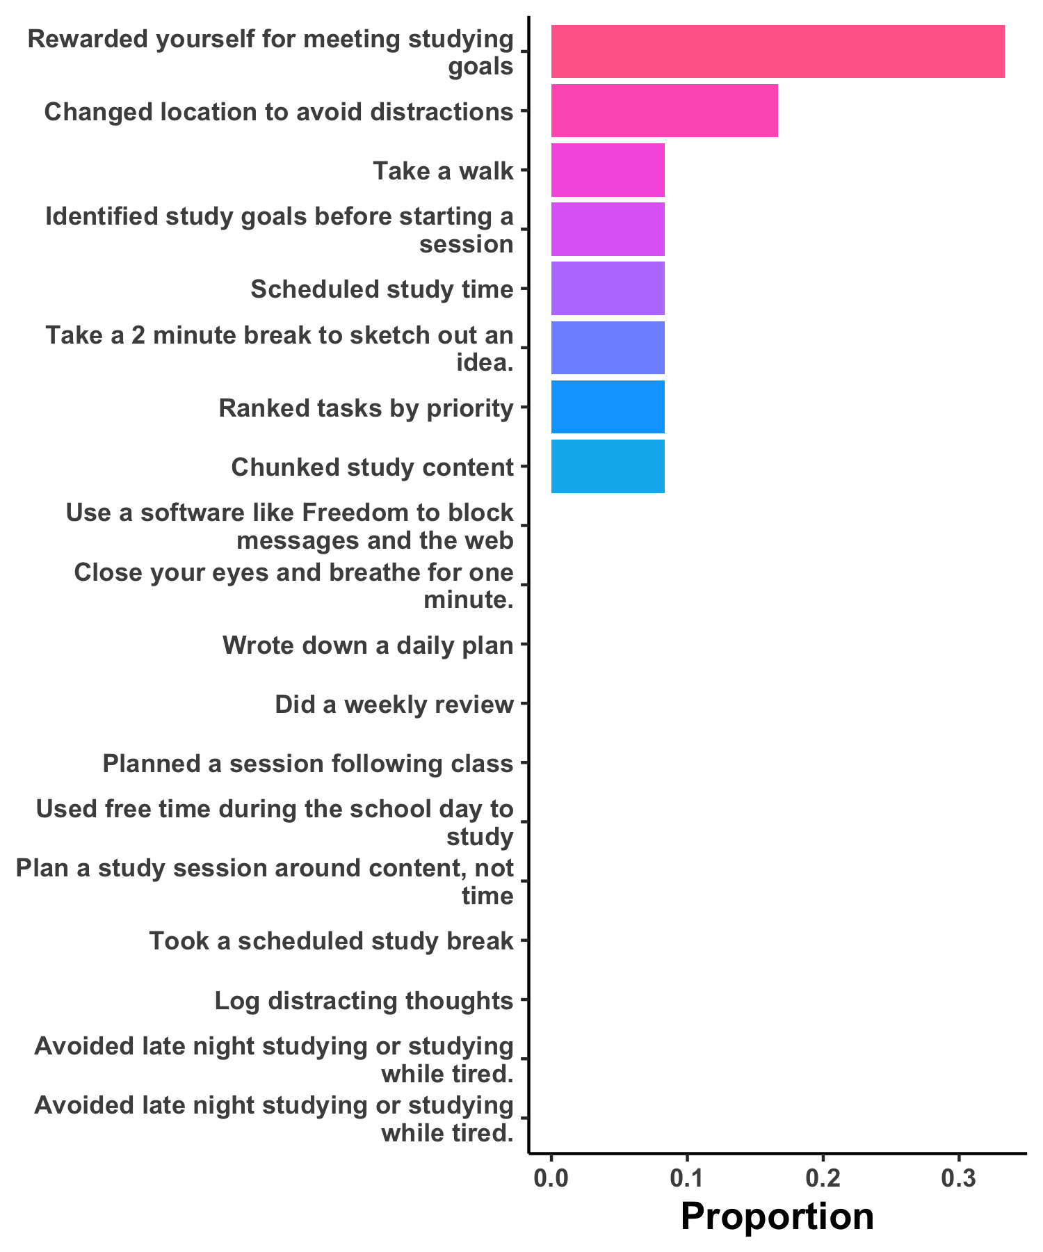
1: ESM | 2: Modeling | 3: Intervention | 4: ESM | 5: ESM

Slide 124
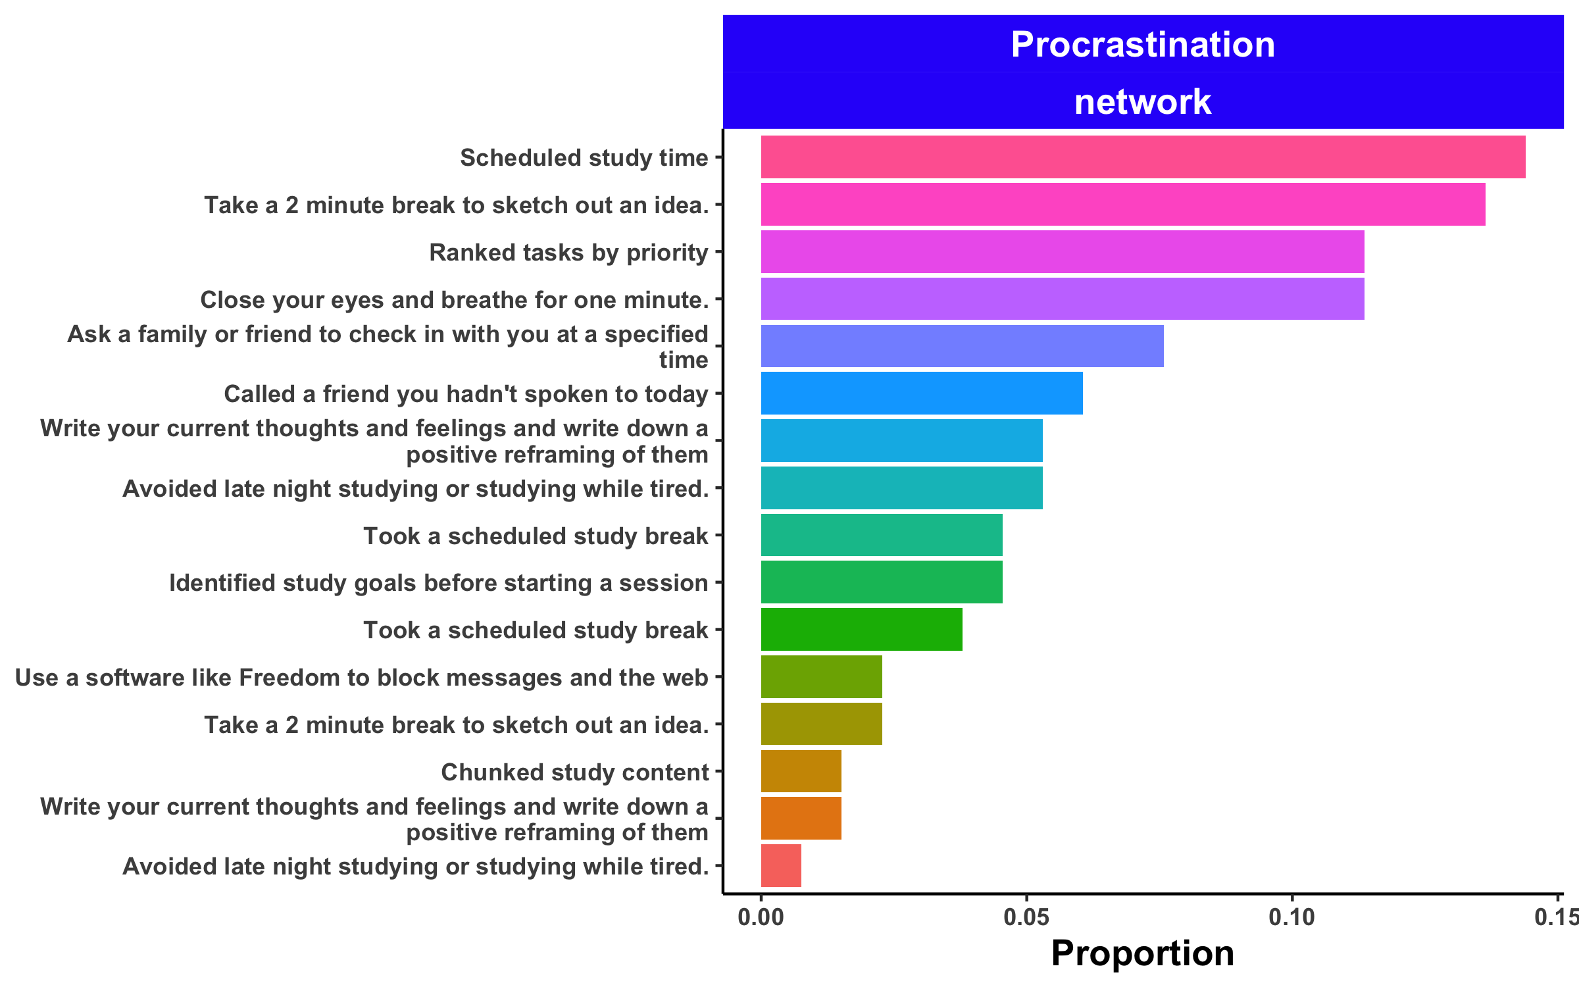
1: ESM | 2: Modeling | 3: Intervention | 4: ESM | 5: ESM

